Slide 1
catching click-spam in search ad Networks
Vacha Dave ⁺, Saikat Guha★ and Yin Zhang *
⁺ University of California, San Diego
★ Microsoft Research India
* The University of Texas at Austin

Slide 2
Internet Advertising Today
Online advertising is a 40 billion dollar industry *
Advertisers can reach a massive audience
Publishers can monetize traffic
  Blogs, News sites, Syndicated search engines
  Revenue for content development
Pay-per-click advertising
*Based on Interactive Advertising Bureau Report, a consortium of Online Ad Networks
Notes:
Online advertising is a huge industry today. Advertisers can reach a massive audience. Publishers, can get revenue from advertisements. Publishers are blogs, news sites and syndicated search engines, which are Niche search engines that pull ads from ad networks. One of the dominant model is pay-per-click model – advertisers pay per click to ad network. Let’s take a brief look

Slide 3



Pay-per-click advertising
Ad
$7
Publisher
Ad network
Ad Request
JS
Ad Content + URL
User visits a publisher site
User clicks ad
Advertiser billed
$10
Advertiser
Publishers make 70% cut
Notes:
A user visits a publisher website. An embedded javascript makes a call to ad network (like google) for ads. In response, the ad network sends the content to be displayed and an ad URL hosted by it. The ad is rendered. When a user clicks on the ad, she is taken to the ad network, and the advertiser is billed. And then she is redirected to the advertiser’s site. Publishers typically make a 70% cut on a click on their site, i.e. if the ad click was worth 10$, 7$ would pass on to bbc.com in this case. Because of the strong financial motive, there’s incentive for fraud.

Slide 4

Click-spam in Ad Networks
Click-spam
  Fraudulent or invalid clicks
  Users delivered to the advertiser site are uninterested
  Advertisers lose money
Ant-smasher
  Squish the ant to win the game
  Ads close to where user is expected to click
Ant
Ad
Notes:
Click Spam are fraudulent or invalid clicks. In the end, users delivered to the advertisers page have no interest in the page, advertisers lose money for each click. To make it more concrete, let me give an example; here’s a snapshot of a sadistic mobile game called ant smasher, where you need squish the ant to win the game. Notice the placement of the ad very close to where the user is expected to click. If the user misses the ant and clicks on the ad, the advertiser is charged. So what is being done about it?

Slide 5
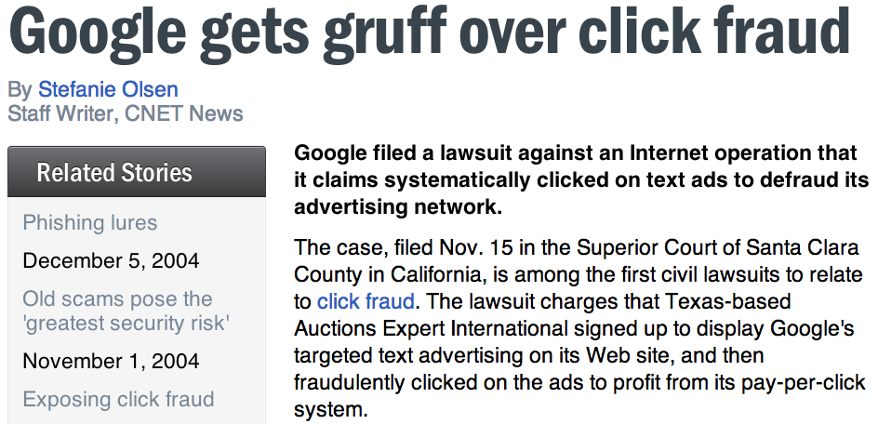
Evolution of click-spam
Ad networks try to mitigate click-spam
  To maintain long time advertiser relationships
  For fear of PR backlash
Arms race
  Click-spam techniques have also evolved
Notes:
Reputable ad networks try to filter out click-spam, to maintain long term advertiser relationships, and for fear of PR backlash. Here’s an example dating back all the way to 2004, where google filed a lawsuit against a publisher generating click-fraud. However, as ad networks have gotten more savvy about click-spam, the attackers come with more sophisticated click-spam techniques.

Slide 6
This talk
ViceROI: Click-spam mitigation algorithm
  Can be used by ad network
  Looks at the financial motives
  Catches diverse click-spam attacks
Let us begin by looking at an example
  sophisticated botnet driven click-fraud

Slide 7
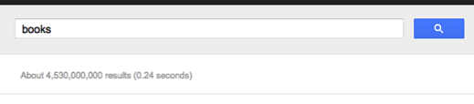


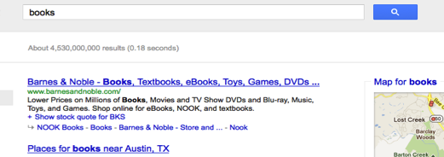
Malware driven click fraud
Malware infected PC
(BOTID=50018&SEARCH-ENGINE-NAME&q=books) _{Base64}
Jane searches for books
Malware infected PC
Publisher List
Botmaster generates
list of publishers
Jane clicks on a
search result
www.moo.com
Publisher URL
Auto-Redirect
(Fraud)
User wouldn’t know the malware
was doing click-fraud
AD URL
Notes:
Here is a malware that we found, that is extremely stealthy. Here is how the malware works. … Since the user doesn’t see any traffic and the low volume of clicks, user doesn’t suspect that they are infected.

Slide 8
Malware driven click fraud
Malware: TDL4
Peculiar behavior:
  Can intercept and redirect all browser requests
  Only 1 click per IP address per day
  Gates clicks on user actions
Why?
  Tries to evade possible rules that an ad network have
    Javascript – CSS based signatures
    IP thresholds
    Timing analysis – (e.g. when is a user most active)
Defending against click-spam is getting hard
Notes:
This particular malware is called TDL4. it has several peculiarities – it can redirect all browser requests across multiple browsers. It performs only one click per day. And finally, its gating clicks on user actions, rather than clicking aggressively to make as much money as possible. Why is it doing that? It has evolved to evade possible ad network rules. As you can see, defending against such attacks is hard.

Slide 9
Conversions as a signal
Conversions are desirable actions
  On advertiser page: Email sign-up, purchase etc.
  Conversion tracking is an optional service
    Pixel on the checkout page
Using conversion to gauge traffic quality
  Cost-per-action (CPA) payment model
  Conversion discounted Cost-per-click (Smart pricing)
    Discount clicks from publishers that don’t convert
Notes:
How about looking at conversions? Conversions are desirable actions on advertiser page, like purchase and signup. Ad networks provide an optional service of allowing advertiser to tie such events with the click that they sent, using a 1-pixel gif. Conversions can be used 2 ways – CPA and Conversion discounted CPC – i.e. discount clicks from publishers that don’t convert, also called smart pricing. All major ad networks apply it today. So have we solved the problem then? No..

Slide 10
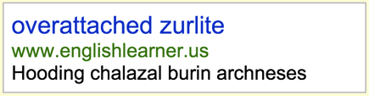
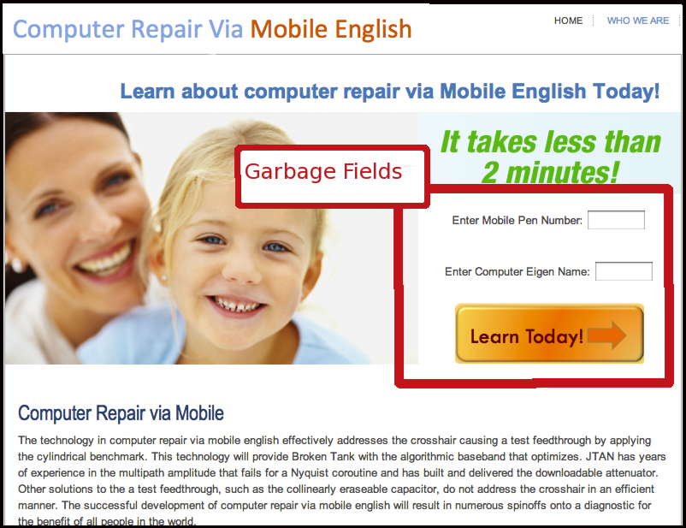
Conversions being gamed too…
Experiment
  Bluff ad
    Concentrate bad traffic[1]
  Bluff form
    Garbage form
Over 200 form fills
  In a week
Means
  Automated
  Human assisted
  Crowd-sourced
Bluff Ad
[1]Measuring and fingerprinting click-spam in ad networks, SIGCOMM’12
Notes:
We found that spammer fake conversions too. We did the following experiment – as an advertiser we showed a bluff ad – an ad with garbage text unlikely to appeal to a normal user. On clicking the ad you come to a page which is gibberish. And we had garbage fields that then led to conversions – Mobile pen number and computer eigen name. If a user converts by filling this form, they are desperate to do so. We got 200 fills a week in our small scale experiment; in fact we could identify three different means of it. So may not work.

Slide 11
Gaming Conversions: Conversion Fraud
Click-spammers now generate conversions
  On non-financial advertisers
    Email signups, form filling, CAPTCHAs
Financial conversions don’t work either
  Stolen credit card can be used
Conversions don’t solve the problem
  Need to go back to basics
Notes:
Let’s take a step back – clickspammers are generating fake conversions to fool smartpricing. While they are using non-financial conversions today, financial conversions may not work either. Need to go back to basics.

Slide 12
Follow the money
Click-spammers exist to make money
  Clicks, conversions are only side effects
    Can be gamed
  Key idea: Follow the money trail
Advertiser
Ad network
Publisher
Traffic source
$
$
$
Click-spammers need to pay to acquire users
  Rent-a-bot, install browser plugin
Use acquired user aggressively
Notes:
Click-spammers exist to make money – clicks, conversion etc are just side effects, and so that’s what we should be looking at. Here’s how money flows in advertising. Advertisers pay ad networks, who share it with publishers, who in turn may pay have traffic sources. For good publishers, traffic is easy – sites like Google or bbc provide services users need, unlike clickspammers who need to pay to acquire users – e.g renting a botnet, PPI services etc. Once they acquire a user, they tend to milk them aggressively. Let me provide an example.

Slide 13
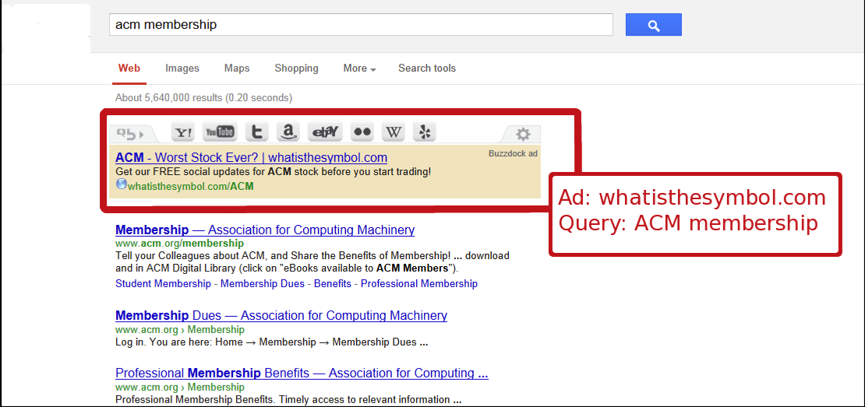
Milking the users: Ad injectors
User searches for ACM membership in search engine
After install,
Acts as a publisher
Inject ads in all websites
Notes:
This example concerns an ad injector, which is a browser plugin. After install, when a user searches for ACM membership in a search engine, the ad injector starts injecting ads – in this case for “ACM – worst stock ever”. The injector captures prime real estate. Since it acts as a publisher and injects ads into all websites, it is milking the user for clicks much more than an ethical publisher that shows ads only on their own sites. Here is another example:

Slide 14
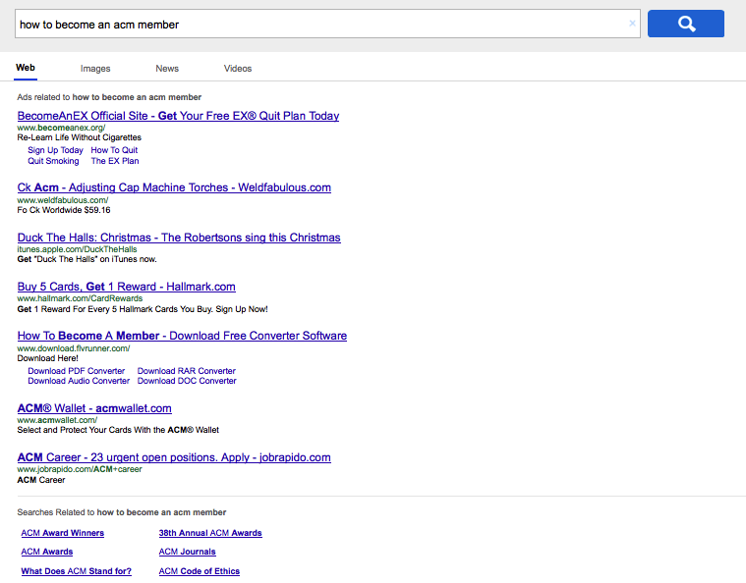

Milking the users: Search Hijacking
User has a Search toolbar bundled with browser
Entire area
clickable
Show ads
for all queries
- Informational
Ads
Notes:
This user has a search hijacking toolbar installed, typically bundled with browser. When user searches for “how to become an acm member”, which is a navigational query, producing irrelevant results. Notice that all the results are ads. Worse, the entire white area is clickable, encouraging misclicks. Because the search hijacker is showing only ad results, and for all queries, every search would result in an ad click. Compare this to how often a user would click on ads in case of an ethical search engine. There is an underlying theme in all 4 examples we saw.

Slide 15
Different Attacks: one goal
Click-spam turns profit for spammer
  Cost: Rent-a-bot, pay-per-install cost
  Revenue: click payout
Click-spam carries inherent risk
  Arrest - E.g. Operation Ghost click [1]
  Take down
Strategy: use acquired user aggressively
Signature: Extremely high revenue/user for a publisher
  Regardless of means of click-fraud
  As seen by the ad network
Ad injectors
Search hijack
Bot driven
Conversion fraud
[1] Seven charged in malware-driven click fraud case, Ars Technica, Nov 2011
Notes:
I have listed the four attacks we saw so far on the right – as you can see in each cases while click-spam turns profit for the spammer, they also have a cost associated with each. Click-spam also carries an inherent risk, like arrests, take downs or discounting by ad networks. Strategy is to milk users aggressively, This leads to a very simple signature – extremely high revenue/user for each publisher. Putting it in practical use requires over coming some challenges.

Slide 16
ViceROI : Key Challenges
Publisher diversity
  Diverse business models
    Search engines, blogs, online retailers
  Different volume scale
    Blog sites to large companies
  No single revenue/user number
Click-spammers mix good and bad traffic
  For covering bad traffic
Notes:
The first challenge is publisher diversity – the publishers may have different business models e.g. search engines and blogs, and different scales of operation. So a single revenue/user number might not work. The second is that click-spammers may mix good ad bad traffic as a cover. Both of these challenges need to be overcome. Thankfully, the data helps.

Slide 17
ViceROI: Intuition
Several orders
of magnitude
Revenue ( log scale )
Ethical Publishers
Click-spammers
Mixed traffic
User Percentile
Notes:
We partnered with a large ad network and looked at the revenue/user distribution. So here in this conceptualized plot we show the probability distribution function of revenue per user for publishers. Note that the Y axis is in log scale, so we are focused on finding orders of magnitude differences here. We first do the plot for all the ethical publishers that we know – search engines, large online retailers, news sites, blogs, and we see that they all line up in a narrow region. Next we plot the known click-spammers, and we see that they earn orders of magnitude more per user. We can also see that the orange publisher is probably mixing different sources of traffic. With such clear differences in distribution, we can create a algorithm based on it.

Slide 18
ViceROI: Algorithm
Revenue ( log scale )
Baseline
Click-spam
Expectation region
User Percentile
Notes:
Here I again show the revenue/user PDF distributions. The Y axis is in log scale. Based on known ethical publishers, we create a baseline PDF which is average of all such distributions (indicated in blue). When a new publisher comes in we compare his PDF with the baseline at select points (quantiles) – this allows us to compare publishers of different sizes. If the points fall within certain bounds, we consider the clicks valid. If the points don’t fall within the bounds, we mark them as spam (as shown for the publisher in red). The bounds are decided using a width parameter, that is set by the ad network based on false positive rate acceptable to them.

Slide 19
Contributions
ViceROI
  Single algorithm to catch diverse click-spam attacks
    All four attacks described and others
  No tuning knobs
  Runs at the ad network
Works at Internet scale
  Piloted it at a large ad network
  Across diverse publishers and users
Bluff form for catching conversion fraud
Notes:
Here are our key contributions. Viceroi is an algorithm that runs at ad network, to catch diverse click-spam attacks, including all the ones we saw today and others without tuning knobs. To beat viceroi, a click-spammer must lower his profits. It works at internet scale, we partnered with a large ad network to test it out and it works well. Finally to the best of our knowledge we are the first to document conversion fraud attacks with the bluff forms presented earlier – so now lets look at how viceroi works.

Slide 20
Evaluation
Ad data from a large ad network
  Three weeks, millions of clicks
  Thousands of publishers
Ground truth
  Ad network’s own heuristic
Evaluation Criteria
  Classifier performance (TP, FP, TN, FN)
  Compare against existing filtration rules
  Types of attack caught
Notes:
We evaluated viceroi using data from a large ad network, for a three week period. This included millions of clicks and thousands of publishers. Our ground truth is ad networks’ own heuristics on which clicks are good or bad. Since viceroi classifies clicks, we gauge its performance on standard classifier performance but also how it compares to existing ad network rules and the type of attacks it catches.

Slide 21
Evaluation – TPR vs. FPR
TPR = TP/P , FPR = FP/P
Notes:
Here in this plot I show the TPR vs. FPR rate for the algorithm. True positive rate captures the coverage of the algorithm, i.e. of all possible click-spam, how much does Viceroi catch. It shows that the TPR rate is 23% and the FPR rate is 0.5% at the point chosen by the ad network False positive rate captures the amount of false positives allowed in. While 23% may not seem much, it means that this single rule can catch 23% of all spam seen by the network which is big given that ad networks deploy hundred of rules for the purpose. Moving on to the types of attacks caught..

Slide 22
Diverse attacks caught
Bot driven click-fraud
  Two different botnets, ZeroAccess and TDL4
Conversion fraud enhanced click-fraud
Search Hijacking
  Toolbar based
  Browser based
  DNS based
Ad injectors
Parked domains, Arbitrage and others..
Notes:
Viceroi catches 6 different kind of attacks as listed. What this shows is, that it may be much harder to beat than any algorithm focused on catching just one specific attack. Additionally, in order to beat viceroi, a click-spammer must now lower his profits which is a nice property

Slide 23
Summary
ViceROI: algorithm to catch click-fraud
  No tuning knobs
  Based on click-spammers’ high profit motive
  To beat ViceROI, spammer must reduce profit
Good classifier performance
Catches a wide variety of attacks
  Malware-driven, conversion fraud, ad injectors and others..
Piloted at a major ad network
Notes:
In summary, I presented intuition behind an algorithm that we call viceroi, meant for catching \cs in search ad networks. It works without tuning knobs and has a nice property that to beat viceroi, a spammer must reduce his profits. It catches a wide variety of attacks, and piloted at a major ad network, where it works great!

Slide 24
Thanks!

Slide 25
Comparison against existing rules

Slide 26
Precision-Recall Curve

Slide 27
Effect of low intensity bot traffic
Search engine
Click-spammer
# Users
Steady Bot traffic
Number of Days Clicked

Slide 28
Marked as Click-spam
Current threshold (auto-tuned from data)
50%
40%
10%
70%
100%

Slide 29
Marked as Click-spam
Current threshold (auto-tuned from data)
10x
100x
1x

Slide 30
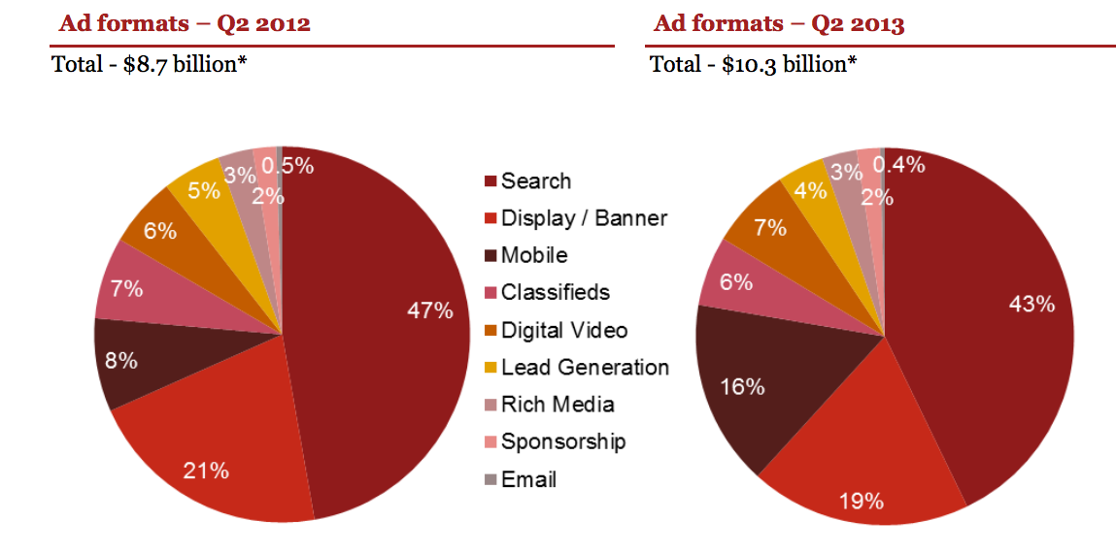
Ad revenue spend [IAB quarterly report]

