Slide 1
Monetizing ZeroAccess
Inside the Click Fraud Malware
Paul Pearce
University of California, Berkeley
With: Chris Grier (Berkeley/ICSI), Vern Paxson (Berkeley/ICSI), Vacha Dave (Microsoft/UCSD), Saikat Guha (Microsoft), Damon McCoy (George Mason), Kirill Levchenko (UCSD), Geoffrey M. Voelker (UCSD), and Stefan Savage (UCSD)
Notes:
Call out Vern as advisor

Slide 2
In This Talk
What is ZeroAccess?
How it works
  Peer-to-peer command & control
  Takedown Resistance
Monetization strategies: Click fraud
  Technical details
  Players and infrastructure
Takedown and Resurrection
Aggregate botnet and advertising behavior

Slide 3
What is ZeroAccess?
ZeroAccess (ZA) is a malware delivery platform
  Core ZA: Simply a mechanism to distribute other pieces of malware
  Payload decoupled from infection
Estimated size: 1.9 million (Mid 2013, Symantec)
ZA’s payload monetization strategy has evolved with changes in the underground economy
  4 known monetization strategies across 5 years
Click Fraud is the current form of monetization

Slide 4





How ZA Works: Peer-to-peer C&C
Peers?
Peers?

Slide 5

How ZA Works: Peer-to-peer C&C
Files?
Files?
Files?
Files?
Notes:
Call out rules for file disambiguation
Call out # of peers
If I need to waste time, add lock to files

Slide 6
ZeroAccess: Takedown Resistance
P2P network uses a combination of obfuscation and cryptography
  Commands are trivially obfuscated
  Files are transmitted encrypted, key derived from in-band information
  Peer list not authenticated
    Sinkhole opportunity (Symantec)
    P2P protocol modified to prevent future sink-holing
Can we distribute our own updates?
  Files are cryptographically signed with an RSA key to ensure authentic files
Takeaway: We have no effective way of shutting down the P2P botnet
*
Notes:
Call out in-band
Call out Symantec white paper

Slide 7
What About The Money?
So far: a robust and complex malware delivery platform
Two click fraud monetization strategies
  Auto-clicking (classic)
  Search result hijacking (advanced)
Focus: Understanding the behavior and economics behind the two click fraud payloads
Notes:
Call out in-band
Call out Symantec white paper

Slide 8
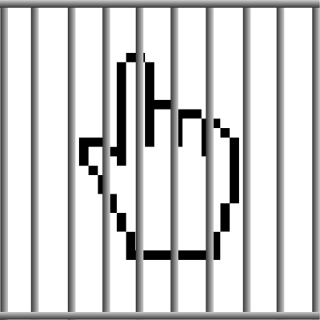
ZeroAccess: z00clicker
z00clicker
  Name comes from malware itself
Older of the two payloads
  Dates back to the second generation of ZA
Less sophisticated of the two
  Think “Classic Click Fraud”
Separate, simple click fraud C&C

Slide 9
ZeroAccess: z00clicker
Produces high velocity, low quality clicks
  Once installed, machine spews ad clicks at an alarming rate
Malware behavior is detectable on the wire
Ad clicks are not visible to the user
  No chance of conversion
For more, please see our tech report

Slide 10

ZeroAccess: Serpent
Search Engine Result Page (SERP) hijacker: Serpent
  Our designation
More sophisticated fraud model
Intercepts user search queries
Hijacks user clicks turning them into advertising clicks
Ad clicks are based off search terms!
Expected higher chance of
conversion ➔ $$$

Slide 11
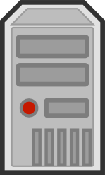
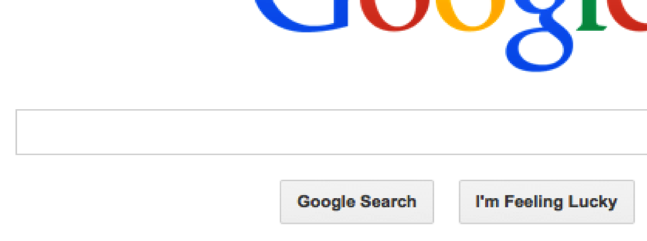



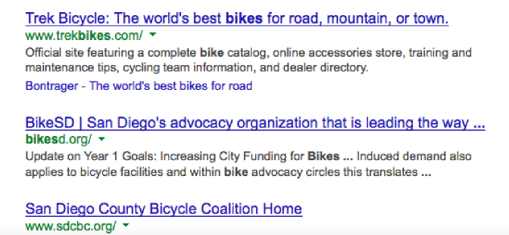






Serpent: Detailed Behavior
Browser
Serpent
Page Fetch
Bikes
(Search Results)
Search Engine
Serpent C&C (Bikes)
(Ad URLs)
Serpent-C&C
Page Fetch
Intended Server
Ad Website
Advertising Victim
Ad Server

Slide 12
Serpent: Advantages
Users are presented with advertising results that are plausibly related to their search
  Users spend face-time at a ad page
  Users are likely to click on some link on the ad page
  Smart Pricing
    Clicks likely to convert are worth more
    ➔ More $$$
Ad click behavior mimics human behavior
  May be harder to detect fraud with conventional approaches

Slide 13
Serpent: Detailed Behavior
Browser
Serpent
Page Fetch
Bikes
(Search Results)
Search Engine
Serpent C&C (Bikes)
(Ad URLs)
Serpent-C&C
Page Fetch
Intended Server
Ad Website
Advertising Victim
Ad Server

Slide 14

Serpent: Ad Click, Expanded
Each click fraud ad click consists of a long redirection chain
Actual Example:
A Serpent
Ad Server
Hype-ads.com
Freshcouponcode.com
xdirectx.com
msn.com
Middlemen
Good or bad?
Good Guys
Bad Guys

Slide 15
Serpent: Milking
Once we understood the C&C, we could interact with it without running malware
Performed more than 16,000 requests for ads
Clicked on a small number of the ads
  Used a user-agent ad networks don’t count
Goal: Map out the infrastructure used for click fraud
Notes:
STOP: CALL OUT WHAT THEY ARE ABOUT TO SEE.

Slide 16
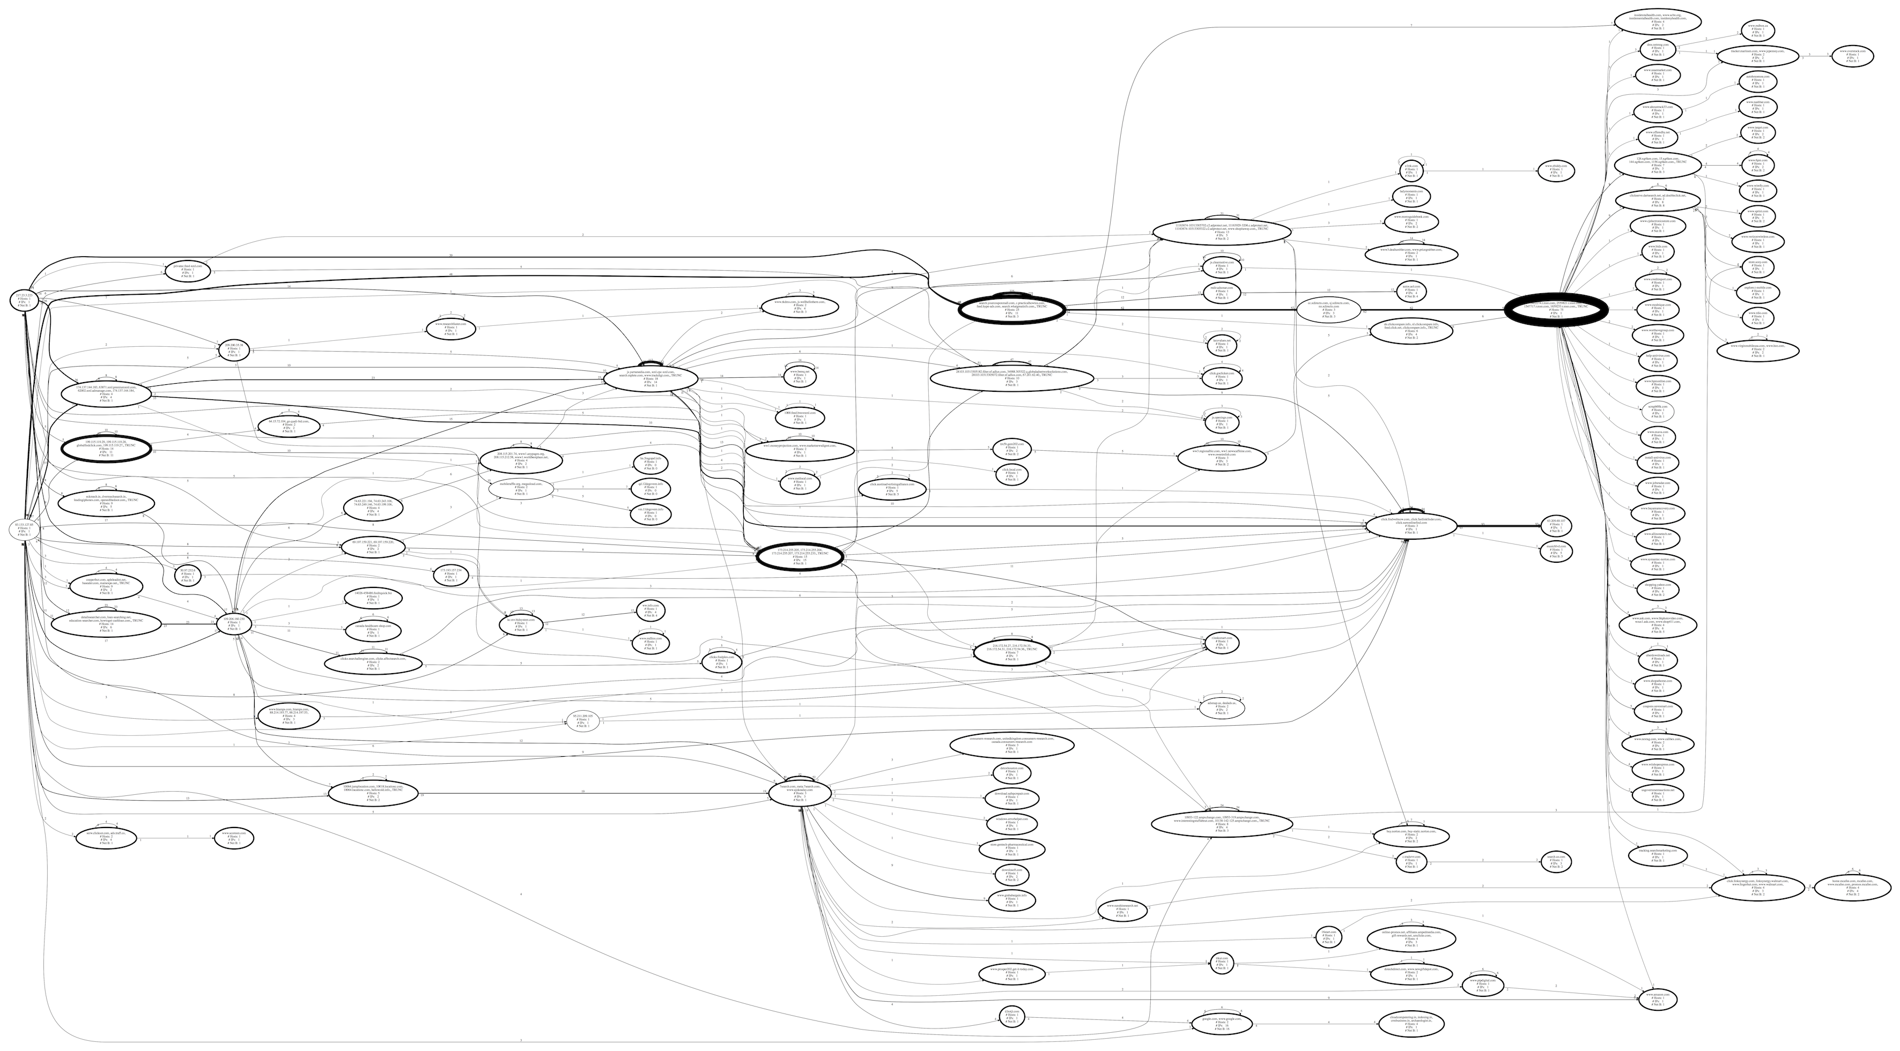
Serpent: Redirects, The Big Picture
Notes:
Discuss entities

Slide 17

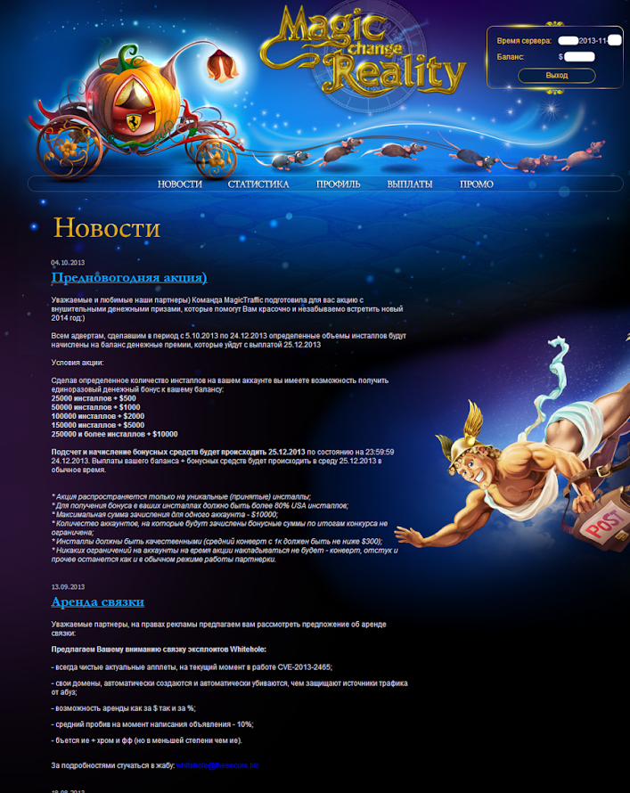
Who’s Running The Show?
Current best understanding based on underground forums
  ZA rented their botnet out to at least two traffic affiliate programs
  MagicTraffic & STI
  MagicTraffic binaries map back to Serpent
Source: http://malware.dontneedcoffee.com/2013/11/magictraffic-look-inside-zaccesssirefef.html

Slide 18
C&C Infrastructure Scope
Throughout various Serpent versions…
  16 IPs were used
  Servers were located in 3 countries
  36 domain names were used
While the P2P infrastructure might be takedown resistant, these 16 IPs are not
As part of our infiltration, we obtained a DNS vantage point of Serpent behavior
  We received DNS packets for most Serpent operations!

Slide 19
The Takedown
December 5th, 8AM PST
Microsoft’s DCU, EC3, and partners move against ZeroAccess Serpent and z00clicker C&C servers
We were able to maintain our DNS telemetry throughout the takedown…

Slide 20
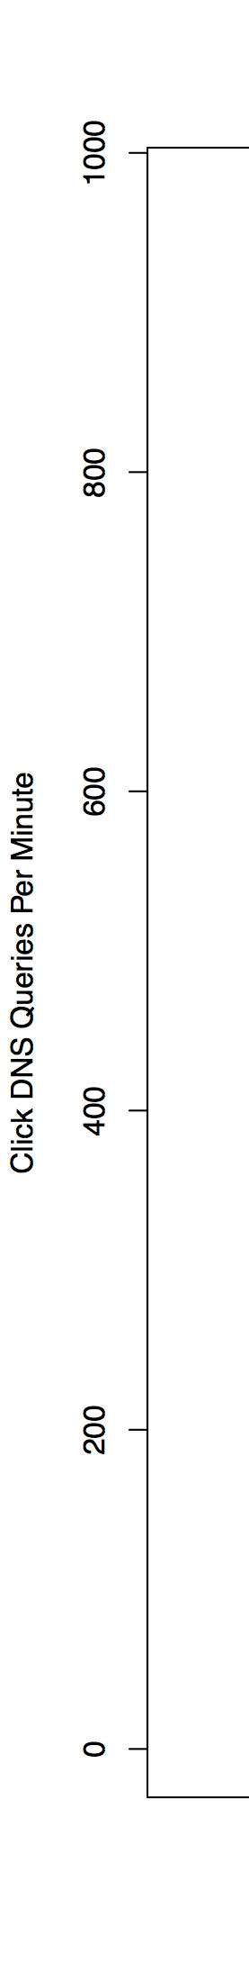
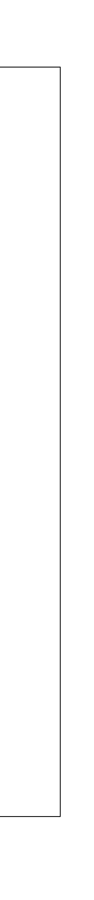
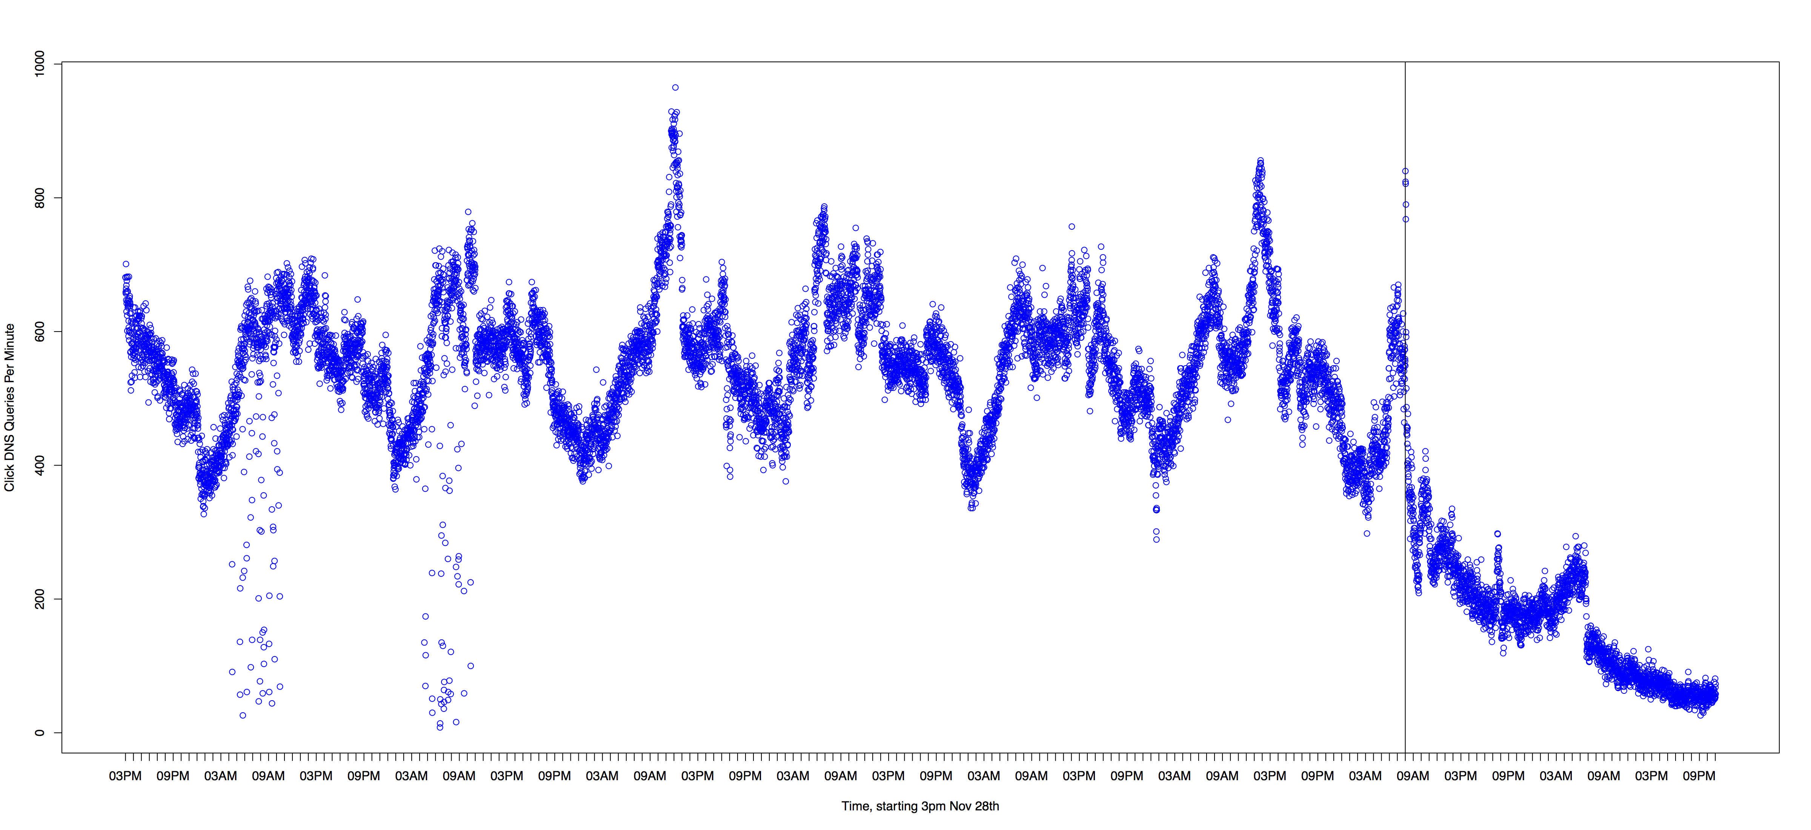
Serpent: Measuring Activity
MS launches takedown
New ZA Payload:
WHITE FLAG
Notes:
Verbal callout: P2P still online

Slide 21
Rebirth
On March 21st, new Serpent modules released to all bot families
“Serpent” in module ID only:
  All Search Hijacking code removed
  Only performed auto-clicking
Several updates have gone out
As of today, fraud continues

Slide 22
Changing Direction:
Aggregate Ad Behavior
Can we say something about the volume of ZA fraud?
What does the click fraud look like from an advertiser perspective?
  This vantage obtained from collaboration with a large real-world ad network
Can we leverage other data sources to help identify badness
  ZA P2P Data
  ZA Serpent DNS data
This is ongoing work, still being developed

Slide 23
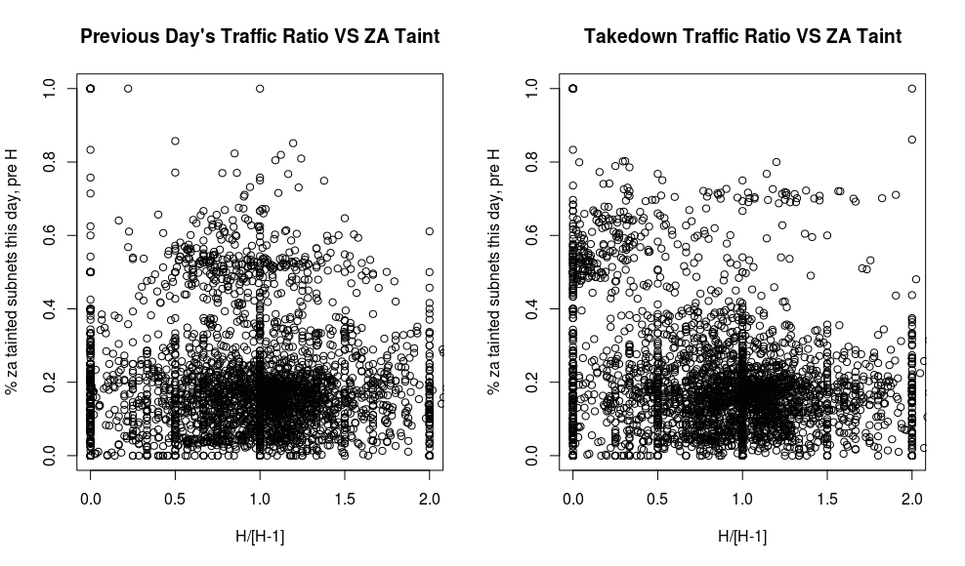
Aggregate Ad Behavior

Slide 24
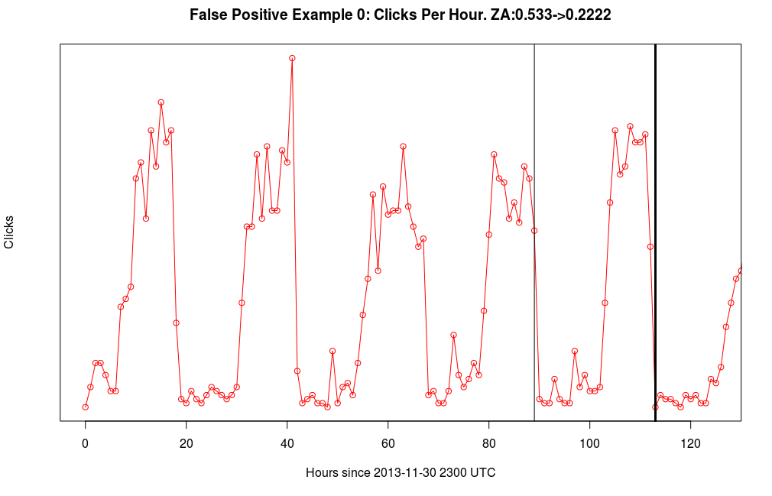
Aggregate Ad Behavior

Slide 25
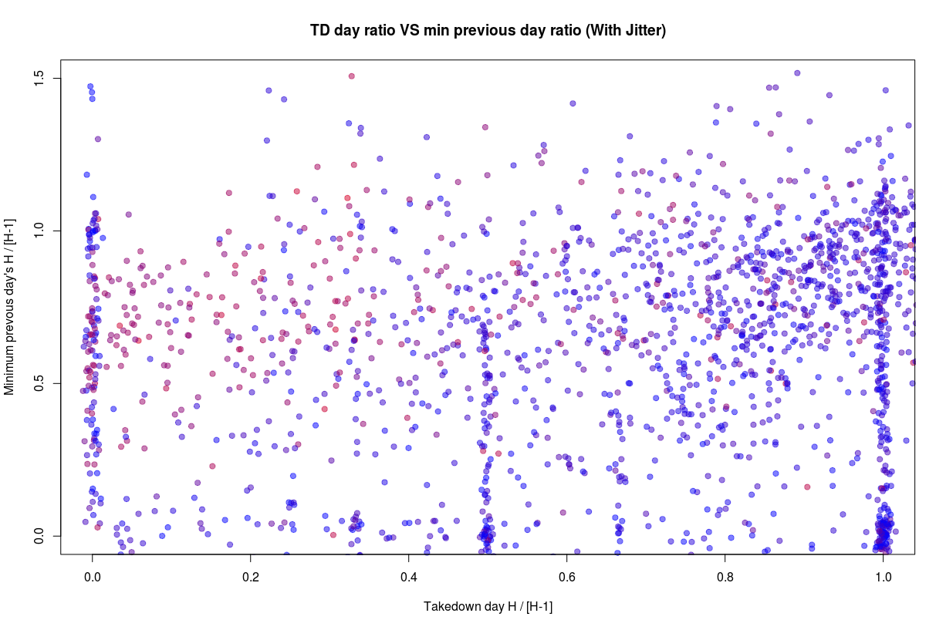
Aggregate Ad Behavior

Slide 26
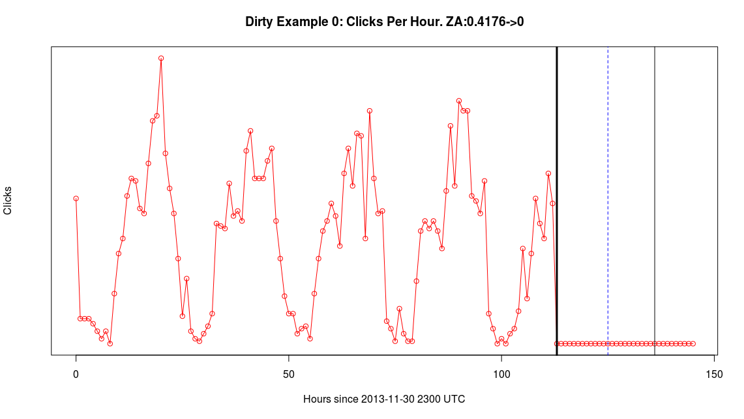
Aggregate Ad Behavior

Slide 27
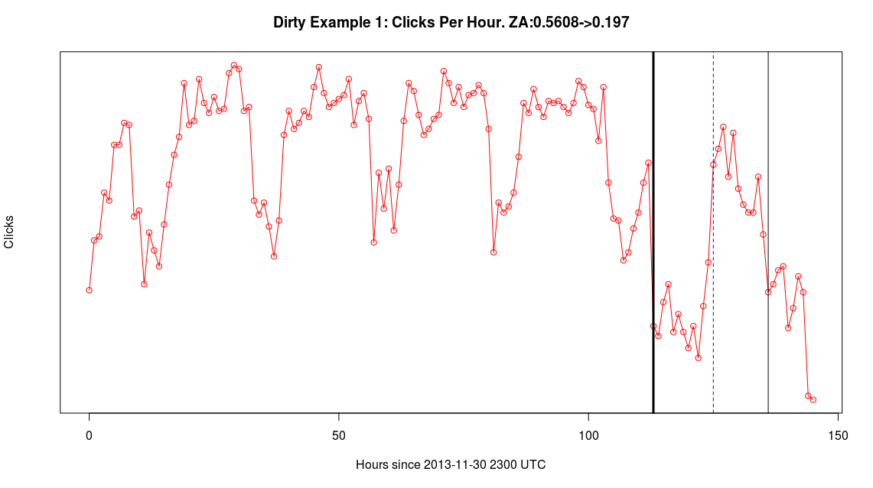
Aggregate Ad Behavior

Slide 28
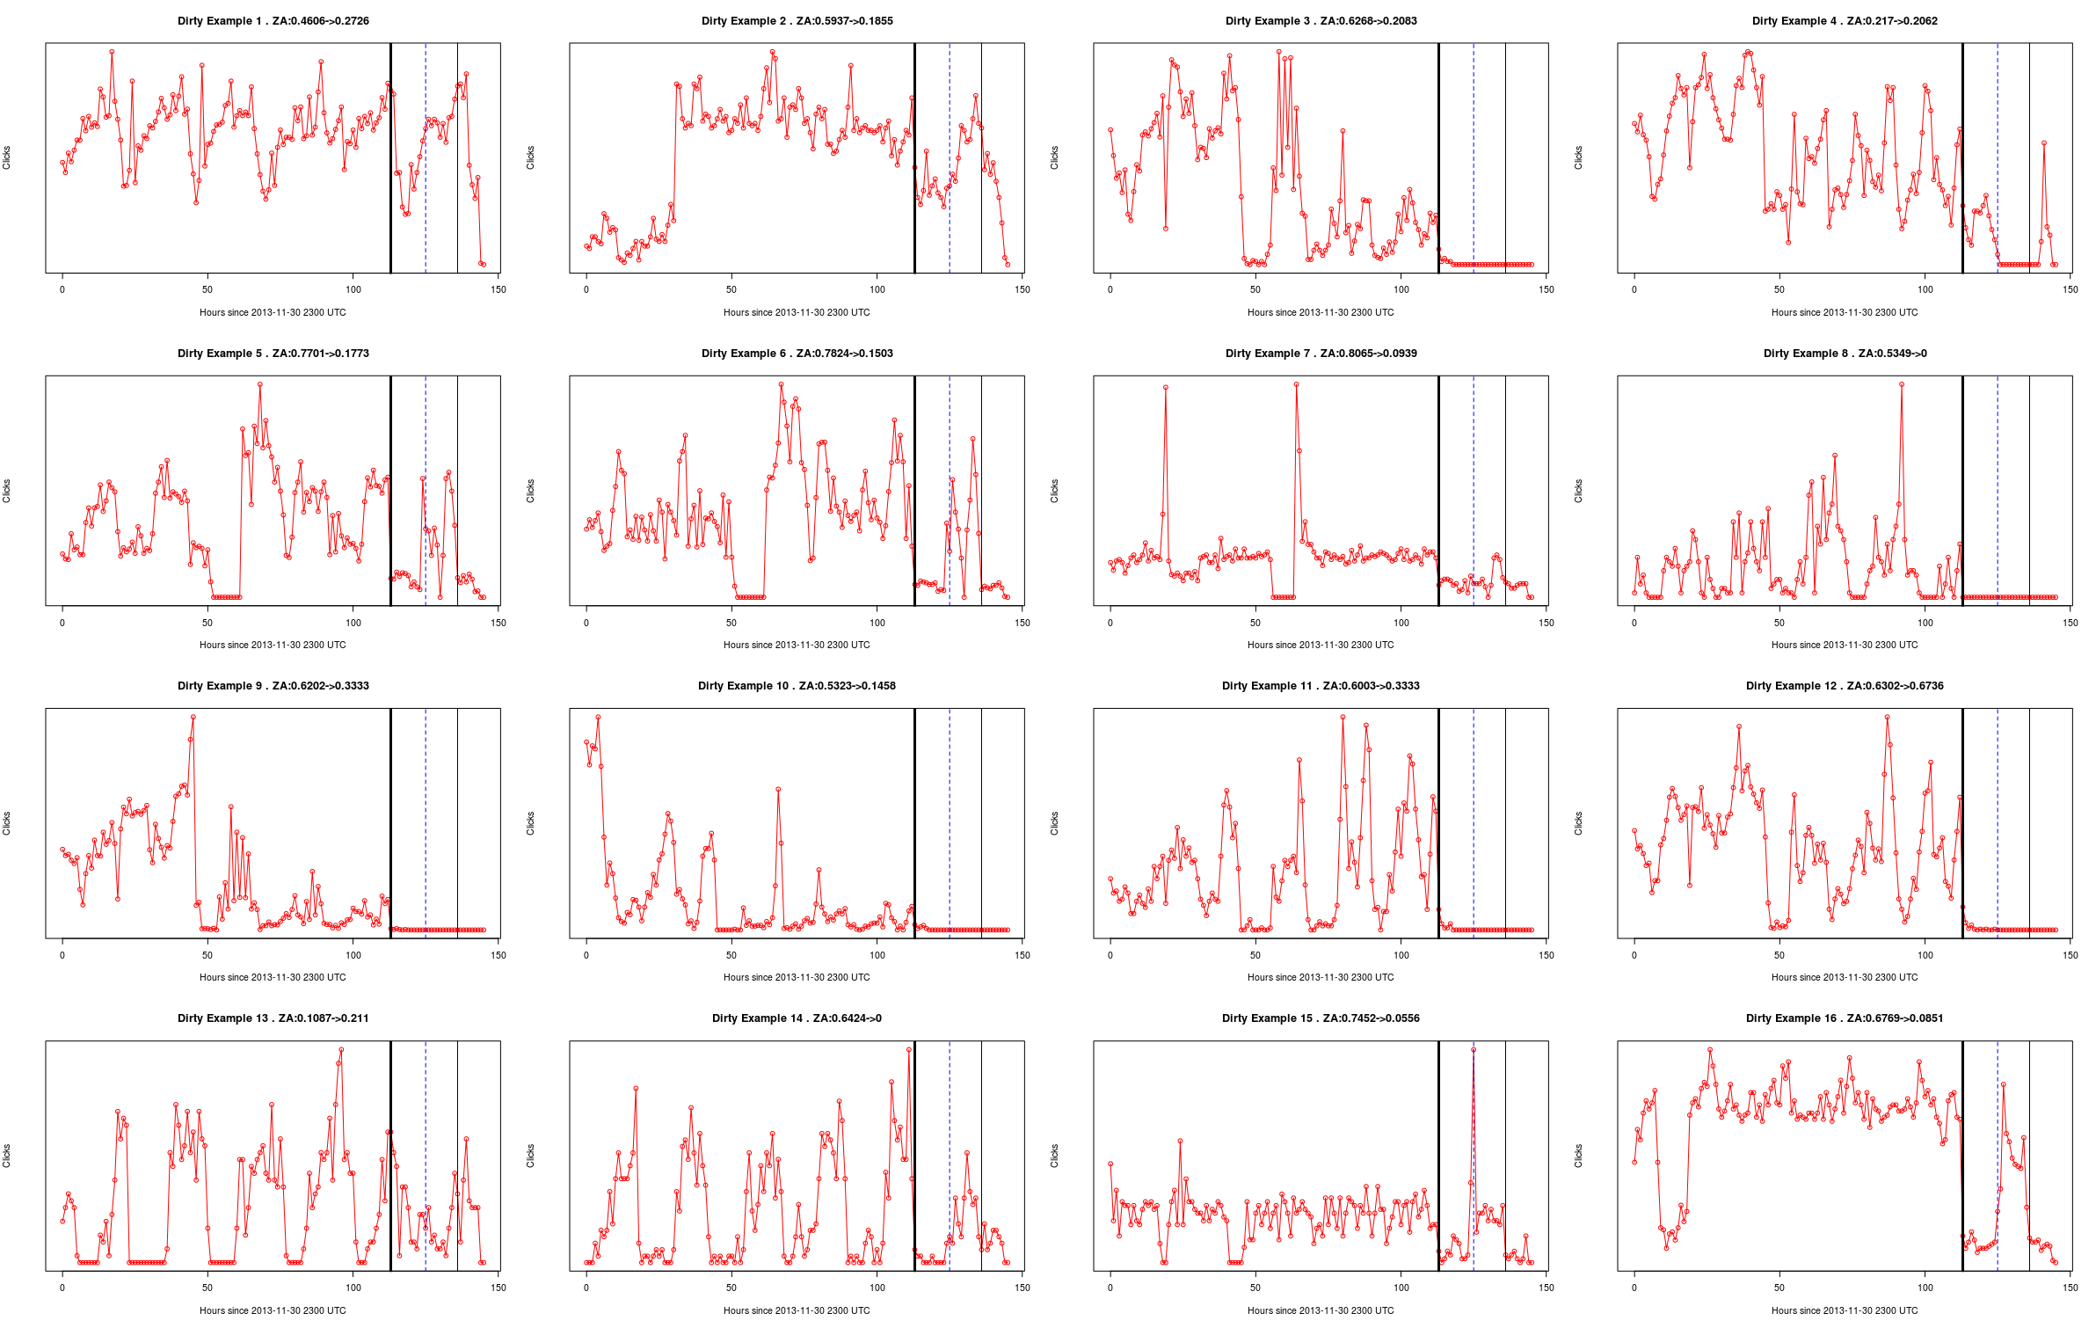
Aggregate Ad Behavior

Slide 29
Aggregate Ad Behavior
~50 ad units identified thus far
These units generated order 100,000 clicks per day prior to take down
Identification, Analysis Ongoing

Slide 30
What’s Next?
Continue analysis of the ad network vantage
Detailed forensic analysis of DNS Serpent telemetry to characterize the aggregate botnet behavior
  Key for understanding the scope of the fraud beyond one ad network
Continue mapping out the click fraud affiliate ecosystem looking for economic or structural weak points
Interested in or have experience with ZeroAccess?
  Come talk to us!

Slide 31
Questions?
pearce@cs.berkeley.edu

Slide 33
Stop

Slide 34




The Research Team
Center for Evidence-based Security Research (CESR)
  UCSD, UCB, International Computer Science Institute (ICSI), George Mason
  Funding from the US National Science Foundation and many strong supporters
We do a bunch of things, but mainly we focus on the
economics and social structure of e-crime
  http://evidencebasedsecurity.org/
University of
California, Berkeley

Slide 36
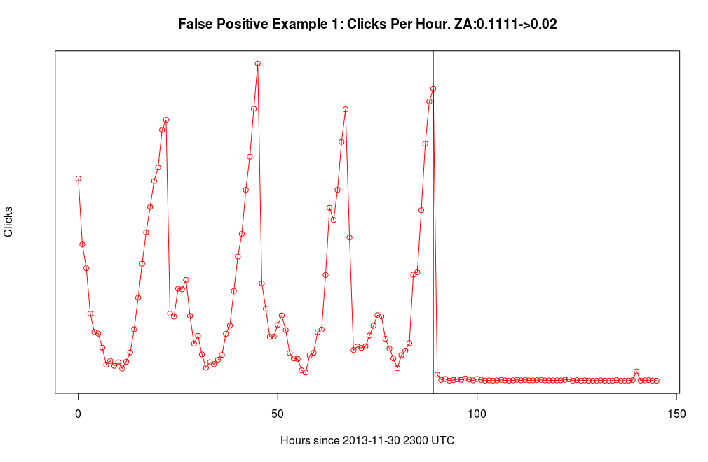
Aggregate Ad Behavior

Slide 37

Finding a New Way to Monetize
Second generation ZA:
  Abandoned FakeAV
  Two new monetization strategies
    Bitcoin mining
    Click Fraud
      Classic click fraud
      Low quality (high velocity, low conversion)
Notes:
Call out in-band
Call out Symantec white paper

Slide 38
ZA: In The Beginning
ZeroAccess: First Generation
  2009-2011
  Kernel Rootkit
  No peer-to-peer behavior
  Estimated size: 250,000 (Symantec)
  Advanced rootkit and AV countermeasures
  Described as a “platform to deliver malicious software”
See white paper from Infosec Institute
Notes:
Call out doubling

Slide 39
ZA: Building a Better Botnet
Second generation ZeroAccess
  Era: 2011-2012
  Still a kernel rootkit
  Estimated doubling in size 500,000 infections (Kindsight)
Complete infrastructure shift
  UDP Peer-to-peer (P2P) malware delivery command & control (C&C)
  Extremely takedown resistant
See white papers from Sophos and Symantec
Notes:
Call out doubling

Slide 40
ZA: Continued Evolution
Third Generation ZA
  Era: Mid 2012 – Present
  Estimated size: 1.9 million (Mid 2013, Symantec)
  Command & control tweaks to increase takedown and network robustness
    Introduction of TCP into parts of the C&C Protocol
Same high-level P2P behavior as before
See white papers from Sophos and Symantec
Notes:
Call out quadruple

Slide 41


Online Advertising: Primer
Goal: I want to bring visitors to my website
Players
  Advertisers – e.g.
  Publishers – e.g. MyBlog.com
  Ad networks – e.g.
  Middle men (syndicators) – e.g.
    Chains of them
Payment models
  Pay Per Impression
  Pay Per Click
  Pay Per Conversion
Notes:
Tease out payment models

Slide 42
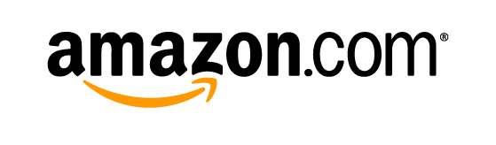
Online Advertising: Click Anatomy
Money
Time
User
MyBlog.com
Ad To Serve
JS To Show Ads

Slide 43
Online Advertising: Click Anatomy
Money
Time
User
MyBlog.com
Page Visit
Page Request
Page w/ JS
JavaScript requests Ad
Returns Ad
Log Impression
Payment
Models
User Ad Click
Ad Click Request
Redirect
Log Ad Click
Page Visit
Advertiser Page
Clicks Buy
Conversion Request
Log Conversion

Slide 44
Online Advertising: Click Anatomy
Money
User
MyBlog.com
Relationships
with traffic
sources
Relationships
with advertisers
and ad networks
Fraud Pain Points
Click fraud is:
  Delivering bogus traffic to advertiser pages
    Impressions, Clicks, and/or conversions
Early Click Fraud: publisher pages
Today: Both publishers and middle men
Middle men can obscure badness from ad network visibility

Slide 45
Click Fraud:
Standing the Test of Time
Third generation ZA:
  Monetization: solely click fraud
Two click fraud strategies
  Auto-clicking (classic)
  Search result hijacking (high tech)
Focus of the remainder of the talk:
  Understanding the behavior and economics behind the two click fraud payloads
Notes:
Call out in-band
Call out Symantec white paper

Slide 46

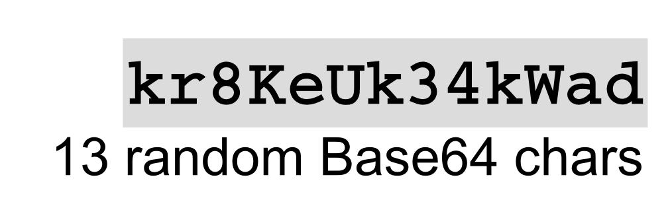
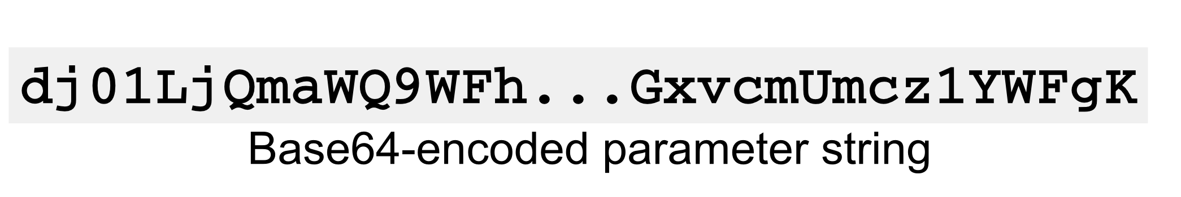
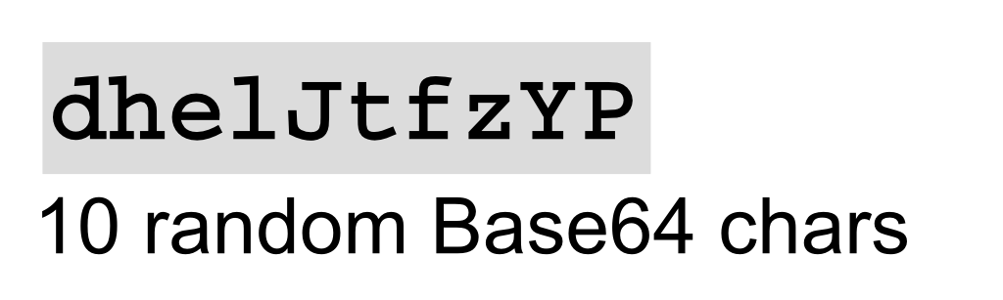

Serpent: C&C
C&C is a standard HTTP GET with some mild obfuscation
Response is encrypted with RC4
  Key derived from message length
Notes:
“Evade automated detection”

Slide 47
The Players
Victims
  Most major ad networks: Microsoft, Yahoo, Google, 7Search…
Middlemen
  Still working to map out and analyze the redirection infrastructure
  But we have some leads
Botnet owners (Botmasters)
  Are they the middle men?

Slide 48
Other C&C and Functionality
Other types of C&C besides just search
Similarly formatted C&C messages occur for a variety of operations
  Confirmation of ad clicks
  Legitimate software updates
In addition, some automated clicking associated with actual user searches
Serpent issues odd DNS queries for each function…
  More on this later

Slide 49
Serpent: Counting Clicks
This is really weird, right?
  Since each pseudo-domain contains an IP address in its actual name, there is no need to do DNS
  This means the domains weren’t registered
We registered a bunch of them
Every bot now signals our server whenever it performs any Serpent C&C operation
  Including every fraudulent ad click!
  ~4 million bot queries per day
  (And we can identify each bot at /24 granularity)
Some tricky DNS bits here to avoid caching and get /24 granularity – Happy to chat after

Slide 51
Switching Gears
In order to investigate the aggregate click fraud behavior, we first need to delve deeper into the technical details of the module

Slide 52
Malware Delivery Platform:
How does it work?
Payload decoupled from infection
When ZA infects a computer, infection asks P2P network what to download
  Downloads and runs independent payloads
Payloads change over time with the evolution of the ecosystem

Slide 53
Methodology
Specimen collection from the wild
  We collect actual malware samples from a variety of industry partners
Binary Analysis
  We statically analyze malware specimens using industry tools such as IDA Pro and Hex Rays

Slide 54
Methodology: Con’t
Monitored Large-scale Malware Execution
  Binaries executed in our GQ honeyfarm
    Flexible network containment
    Operating system event monitoring
Command & Control (C&C) “Milking”
  Milker: Program that speaks a botnet’s C&C protocol
  Once C&C revere engineered, milker lets us explore ZA behavior without executing malware

Slide 55


Click Fraud
Click Fraud is one driving factor
behind modern malware and cybercrime
Victims:
Notes:
“big players getting burned”

Slide 56
Why do we care about ZeroAccess?
Major click fraud player and headache source for several years
  One of the largest botnets in existence (Dec 2013)
    Estimated 1.9 million infected machines
  Has gone through several iterations
  Involved in several types of click fraud
Technically sophisticated

Slide 57
Why do we care about ZeroAccess?
But why is does it interest us?
  We’re all about the money
Innovative revenue model
“State of the Art” click fraud
Our work: Study the relationship between actors in the click fraud space
  Goal: Find infrastructure or economic choke points
  Goal: Discover aggregate click fraud behavior
Notes:
Focus on the phrasing of the last paragraph

Slide 58



ZeroAccess: Infection
ZA platform downloader was distributed via a number of infection vectors
  Drive-by downloads
  Social engineering
  Pirated software

Slide 59
Serpent: On-going
From here on out in the talk, we will be discussing ongoing work we are actively engaged in
Notes:
Basically read this aloud

Slide 60
Serpent: Characterizing Aggregate Behavior
I’ve described how ZA and Serpent work, technically
Our work understanding the affiliate ecosystem is ongoing
What about our other goal? Can we say something about the botnet’s behavior in aggregate?
About those odd DNS requests…

Slide 61
ZA Malware Delivery Platform
Modern ZA acts as a malware delivery platform
  Payload decoupled from infection
ZA platform uses a peer-to-peer (P2P) C&C structure
When ZA infects a computer, ZA downloader it asks the P2P network what to download
  Downloads and runs independent payloads
Main payloads:
  Auto-clicking module (low tech)
  Search result hijacking (high tech)

