Slide 1


Empirical Analysis of Search Advertising Strategies
Bhanu C. Vattikonda, Vacha dave,
Saikat Guha, Alex C. Snoeren
Notes:
Hello everyone, my name is Bhanu, today I am going to present an Empirical Analysis of Search Advertising Strategies. This work was done in collaboration with Vacha, Saikat from Microsoft and my advisor Alex at UCSD.

Slide 2
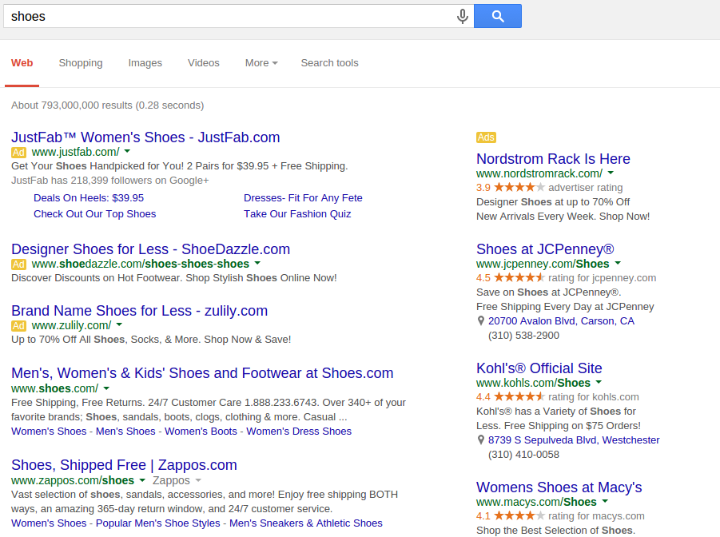
Query
Sponsored
results
Organic
results
Notes:
Search engines that we use every day return a page that looks like this in response to a user query. The page contains are two types of results. Organic results which are chosen from around the web based purely on their relevance to the user query and sponsored results which are chosen based on their relevance and the price that advertisers are willing to pay to have their ad shown to the user. This form of advertising is called sponsored search. Sponsored search is great for advertisers because they can show their ads knowing what the user is looking for. And, the users are also likely to find it less intrusive because the ads are also relevant to what the user is searching for.

Slide 3
Huge and growing industry
20%
Source: IAB/PwC Internet Ad Revenue reports
Notes:
It is no surprise then that sponsored search revenues have grown rapidly over the last decade accounting for 25bn $ last year. With advertisers spending all this money, are the ad strategies that they follow profitable?

Slide 4
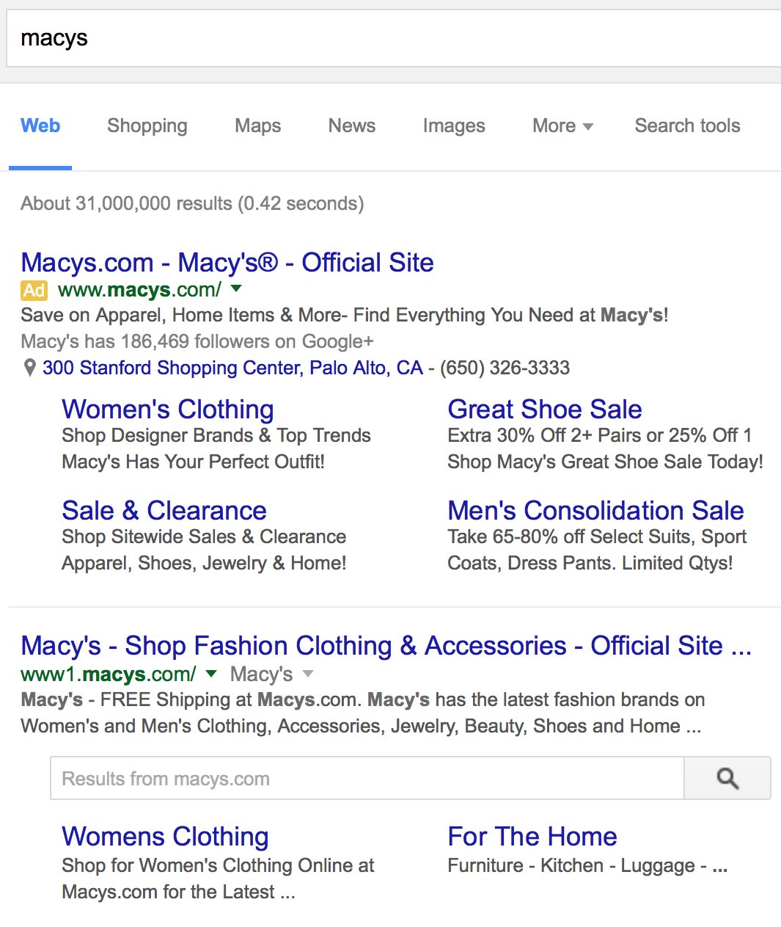
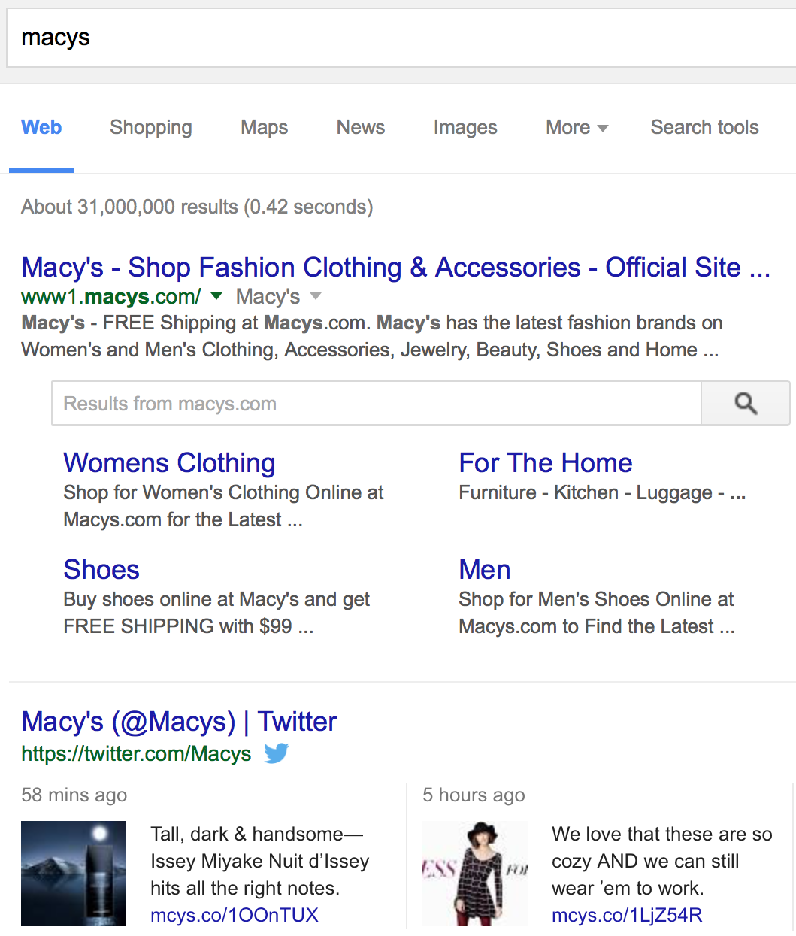
Sponsored
Organic
Notes:
Should an advertiser show an ad when the user is clearly searching for them, like in this case when the user searches for macys, a popular departmental store in the United States. The user is presented with a top sponsored result for macys and then an organic result for macys as well.
Would the user behavior be different if they are shown just the regular organic results for the same query. In which case, the user would be presented with a page that looks like this.
So, the question is, should a brand advertise to users who are searching for them?

Slide 5
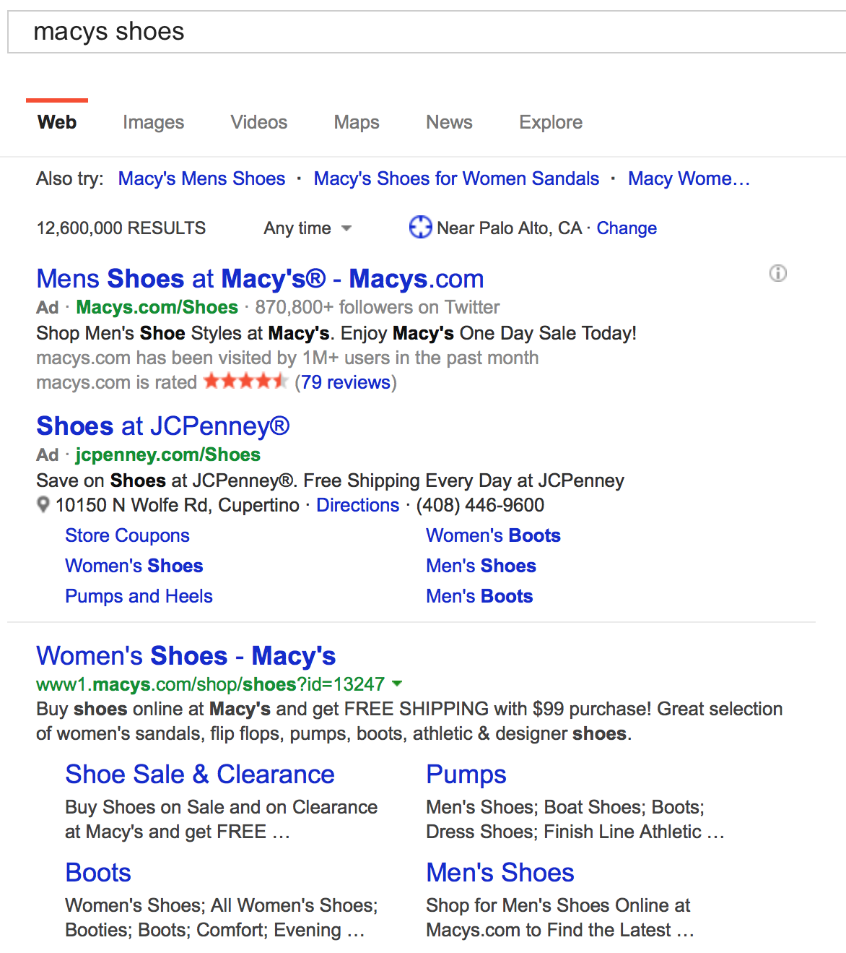
Brand Ad
Competitor Ad
Are common advertising strategies profitable?
Notes:
What about the case when the advertiser targets users who are searching for a competitor. Should the advertiser show ads when the user is clearly not interested in them? For example, should jcpenney, another large departmental store in the United States, advertise for users who are searching for macys?
How about the brand itself, macys in this case, should they try to protect themselves from competitors poaching their users?
In this paper we ask, are some of the common advertising strategies followed by advertisers profitable?

Slide 6
Metrics for campaign analysis
Click-through-rate (CTR)
  Measures ability to attract users but not quality of users
Cost per acquisition (CPA) or cost per conversion:
  Does not capture profitability (e.g., in case of organic results)
Profit-per-impression
  Requires access to sensitive financial information from advertisers
Notes:
To answer this, we have a few metrics that are commonly used. Each has it’s own flaws which make them unsuitable for large scale analysis. One common metric that is used to measure campaign performance is click-through rate. Which measures the number of clicks on the ads as a share of number of times the ads are shown. But, it does not tell us anything about the quality of those users. Do they make a purchase, do they not, etc.
Another common metric is cost-per-acquisition, which is better at measuring how much it costs to acquire a single user. However, even this metric does not capture profitability. For example, when users are acquired through organic results, it does not cost anything. But CPA does not tell us anything about how profitable those users are.
There is one metric that is somewhat rarely used which does capture profitability. This is the profit per impression metric. But, it requires sensitive financial information from advertisers. If we want to do the analysis of advertising strategies at scale, this is not going to get us very far.

Slide 7

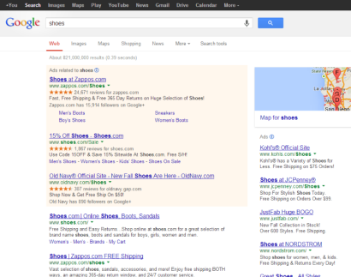
User Flow
Search impression
Conversion
Notes:
To see how we can answer these questions at scale, let’s see how sponsored search works in the first place. A typical user flow looks like this:
The user issues a query to the search engine
In response, the search engine returns a page to the user containing sponsored and organic search results
When the user clicks on one of the links (organic or sponsored), the user is taken to the results page and the search engine makes a record of this user action.
If the user performs a desirable action on the advertiser website, a conversion is said to have occurred.
Some advertisers, report the conversion back to search engine. This allows the search engine to provide analytics support to the advertisers on the performance of their campaigns. This also allows the search engine to tell which particular user click on the search engine led to a conversion. We rely on these conversion signals to conduct our analysis.
The only place where we can analyze advertising strategies at scale is at the search engine. In this study, we analyze the profitability of ad campaigns from the vantage point of the search engine.

Slide 8
Search engine data
User click information
Cost of a particular advertising strategy
Number of conversions that an advertiser receives
How much is a conversion worth to the advertiser?
Notes:
The search engine has rich information about the user and advertiser.

Slide 9
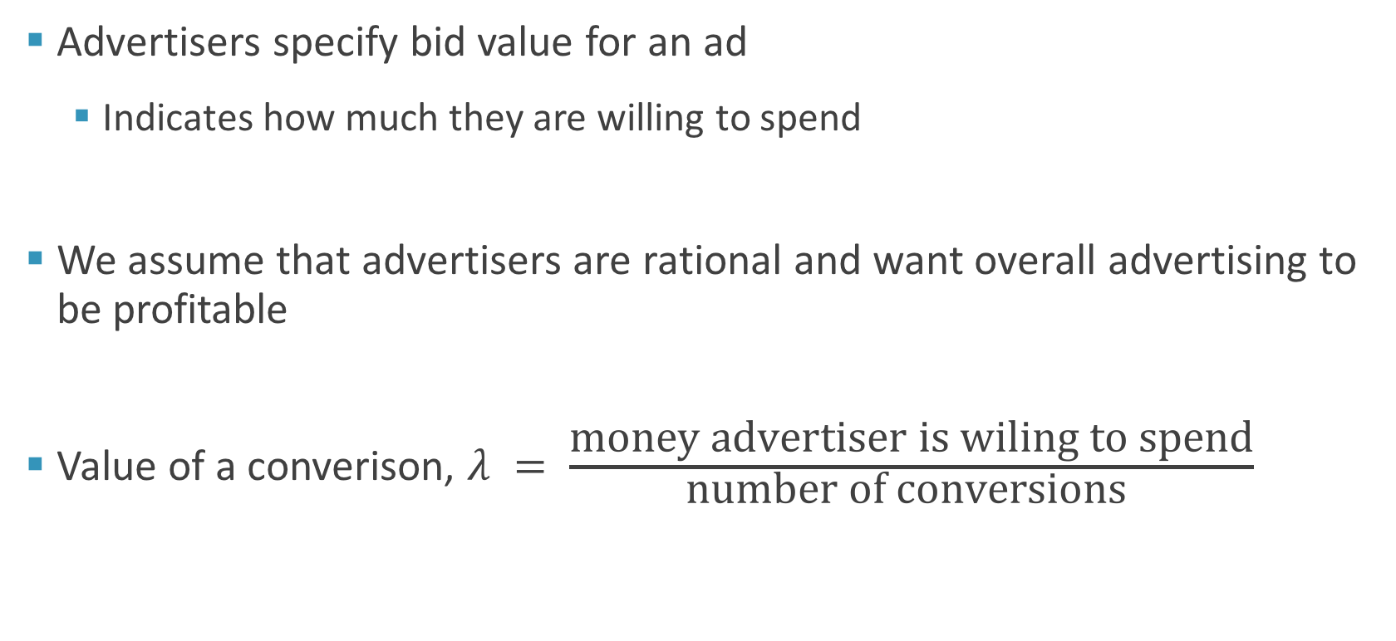
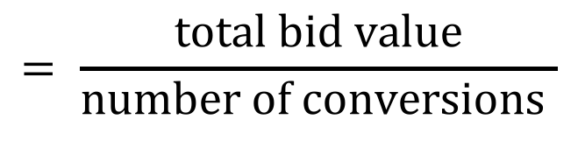
Value of a conversion
Advertisers specify bid value for an ad
  Indicates how much they are willing to spend
We assume that advertisers are rational and want overall advertising to be profitable
Value of a converison, $λ = \frac{\text{money} \text{advertiser} \text{is} \text{wiling} \text{to} \text{spend}}{\text{number} \text{of} \text{conversions} }$
$$= \frac{\text{total} \text{bid} \text{value}}{\text{number} \text{of} \text{conversions} }$$
Notes:
We address the challenge of measuring the value of a conversion by relying on the bid values placed by advertisers. When advertisers run campaigns with the search engine, they specify a bid value which indicate how much advertisers are willing to spend for an ad click.
We assume that advertisers are rational and that they want their overall advertising strategy to be profitable.
From all the different advertising strategies advertisers follow, we see how much were they willing to spend and then divide it by the number of conversions they received from the ads that they ran.
So, the we approximate the value of conversion as “total bid value” divided by “total number of conversions” the advertiser receives across campaigns.

Slide 10
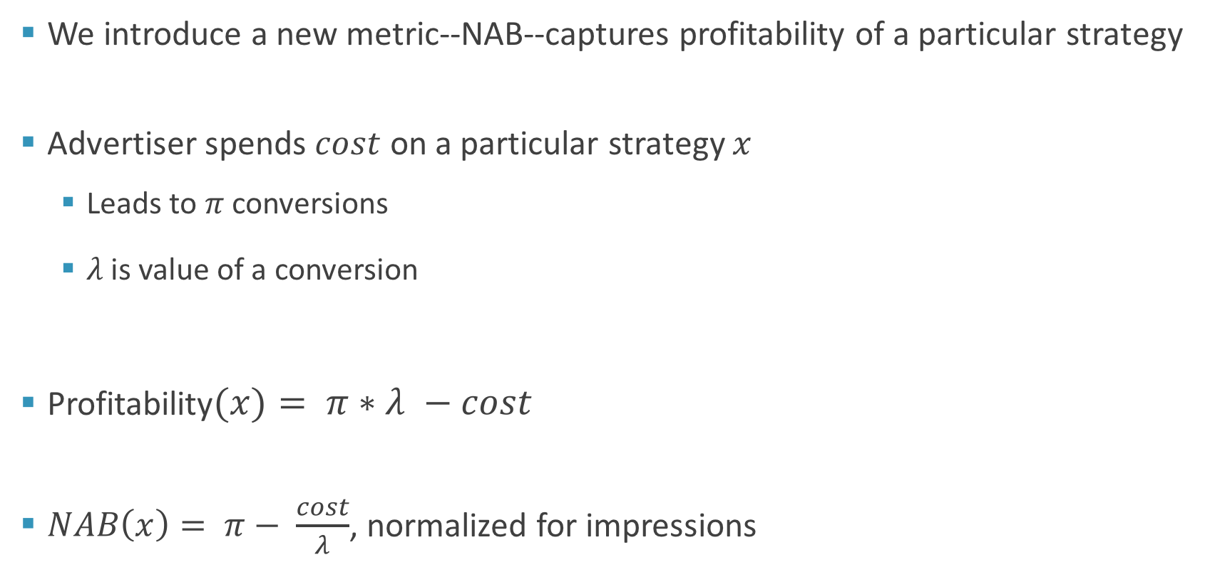
Net acquisition benefit (NAB)
We introduce a new metric--NAB--captures profitability of a particular strategy
Advertiser spends $cost$ on a particular strategy $x$
  Leads to $π$ conversions
  $λ$ is value of a conversion
Profitability$(x)= π∗λ −cost$
$NAB\left(x\right)= π− \frac{cost}{λ}$, normalized for impressions
Notes:
Having obtained an estimate for the value of a conversion to the advertiser, we define a new metric net acquisition benefit or NAB which captures the profitability of a particular strategy.
Let us say the advertiser spends cost amount of money on a particular strategy x. This strategy could lead to pi conversions and lambda is the estimated value of each conversion.
The profitability of this strategy would be defined as pi times lambda – the cost.
We define NAB as the number of conversions achieved by the strategy adjusted for cost. We then normalize this by the number of search impressions that the strategy was executed over. The normalization allows us to compare different strategies. So, NAB is proportional to another somewhat rarely used metric, profit per impression.
So, to compute NAB, we need the cost of a particular strategy, the number of conversions received from following the strategy and and the value advertiser places on each conversion.

Slide 11
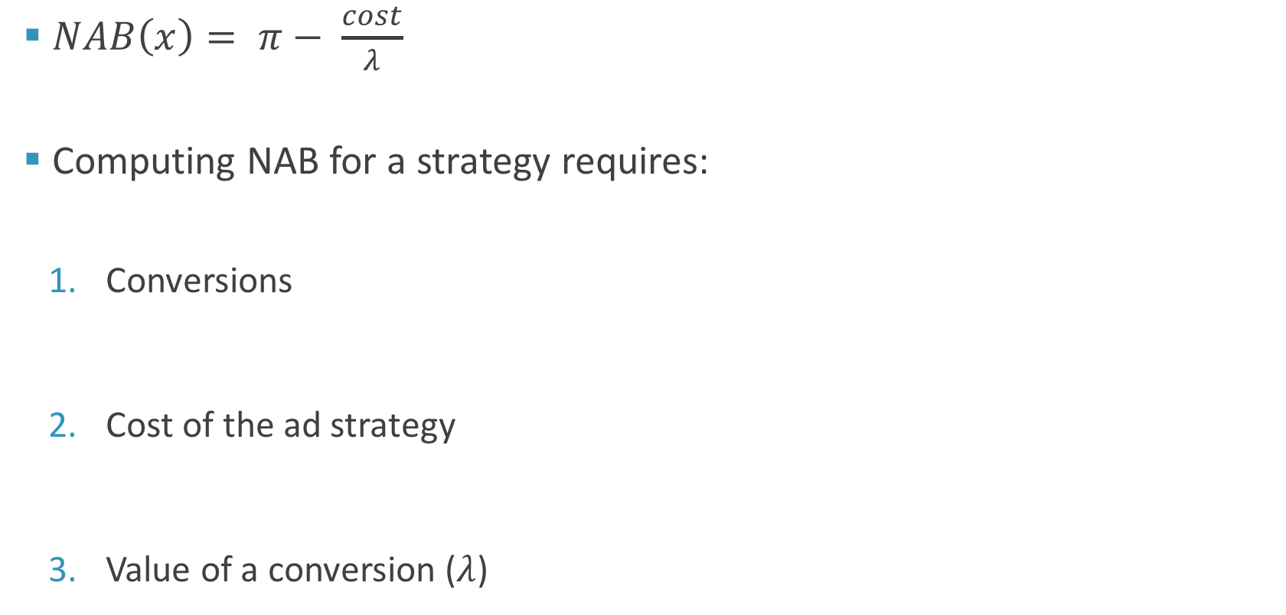
Computing NAB
$NAB\left(x\right)= π− \frac{cost}{λ}$
Computing NAB for a strategy requires:
  Conversions
  Cost of the ad strategy
  Value of a conversion ($λ$)
Notes:
To summarize, NAB is computed as number of conversions adjust for the cost divided by target cost per conversion normalized for impressions. Intuitively this can be seen as conversion probability adjusted for cost.
And to compute NAB of a particular strategy, we require the number of conversions, the cost of the ad strategy and the value the advertiser places on the conversions --- something that we derive from the bid values placed by the advertiser.

Slide 12
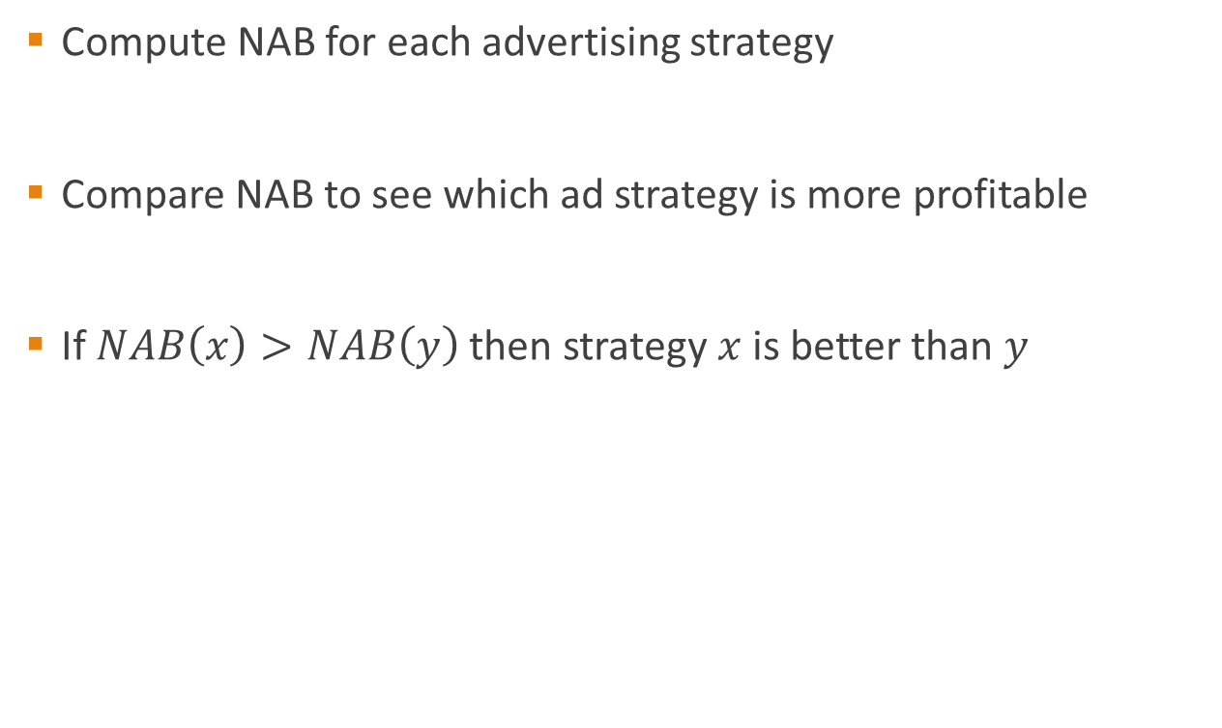
Comparing ad strategies
Compute NAB for each advertising strategy
Compare NAB to see which ad strategy is more profitable
If $NAB\left(x\right)>NAB\left(y\right)$ then strategy $x$ is better than $y$
Notes:
And, NAN allows us to compare the profitability of ad strategies. When comparing ad strategies we compute NAB for each strategy and then compare the NABs to see which ad strategy is more profitable.
If NAB of a particular strategy x is greater than the NAB for another strategy y that means x is a better strategy to follow than y.

Slide 13
Common ad strategies we analyze
Cannibalization
  Advertising for own brand name
Poaching
  Advertising for a competitors brand name
Mobile ad extensions
  Using ad extensions (e.g., call extension) on mobile devices
Notes:
Using this NAB, In our paper we analyze 3 strategies that have garnered quite a bit of press recently. We call the first strategy cannibalization where an advertiser chooses to advertise for their own brand name. The second is poaching where an advertiser advertises for a competitors brand name. Finally we analyze the profitability of using ad extensions, like call extensions on mobile devices.
In this talk, I will just focus on cannibalization.

Slide 14
Sponsored
Organic
Notes:
In particular, we explore, should an advertiser, advertise for their own brand name?
Should macys’ show their ad to users who are searching for “macys”?

Slide 15
Search engine dataset
Month long click log data from a search engine
  Billions of clicks
  Millions of ads
  Conversions for both ad and organic clicks
  Several million dollars of ad spend
  Bid that the advertiser placed for each ad click
Notes:
We do this analysis using data spanning 4 contiguous weeks from a large search engine. The data we use has information about billions of clicks performed by users over this period of 4 weeks.
It spans millions of ads and associated conversions for both ad and organic clicks. This data reflects millions of dollars of ad spend. And, to get the target cost per conversion, we also use the bid value placed by the advertiser on each of the ad clicks.

Slide 16
Advertising for own brand name
Advertise for brand name
  NAB is computed over search impressions where user searches for brand name and ad is shown
Do not advertise for brand name
  NAB is computed over search impressions where user searches for brand name and ad is NOT shown
Notes:
For the question of “should advertisers target their own brand name”, we are essentially looking to compare two advertising strategies.
For example: an advertiser could make the decision to advertise for their own brand name. In this case, when we measure the profitability we look at the profitability of the advertiser over search impressions where the user was searching for the brand name and the advertiser had their ad shown.
To evaluate the profitability of the advertiser decision to not advertise on their brand name, we look at search impressions where the user still searches for the brand name but is not shown an ad by the advertiser.

Slide 17
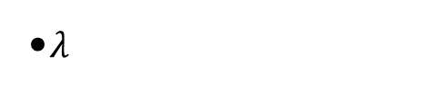
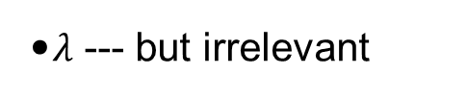
Advertising for own brand name
Yes, advertise
No, do not advertise
Impressions
  Users search for brand and advertiser ad is shown
  Users search for brand and advertiser ad is not shown
Conversions
  Total number of conversions through ads and organic results
  Number of conversions through organic results
Cost
  Cost of campaign
  0
Target cost
  $λ$
  $λ$ --- but irrelevant
Notes:
One is to, yes, advertise for brand name and the other is, no, do not advertise for brand name.
The impressions over which NAB is computed in the “yes” scenario are when the user searches for the brand and advertiser ad is shown. In the no scenario it would be all the impressions in which the user searched for the brand but an ad by advertiser was not shown.
In case of ads being shown, conversions could come from both organic and ad results. Whereas when ads are not shown conversions come only from organic results.

Slide 18
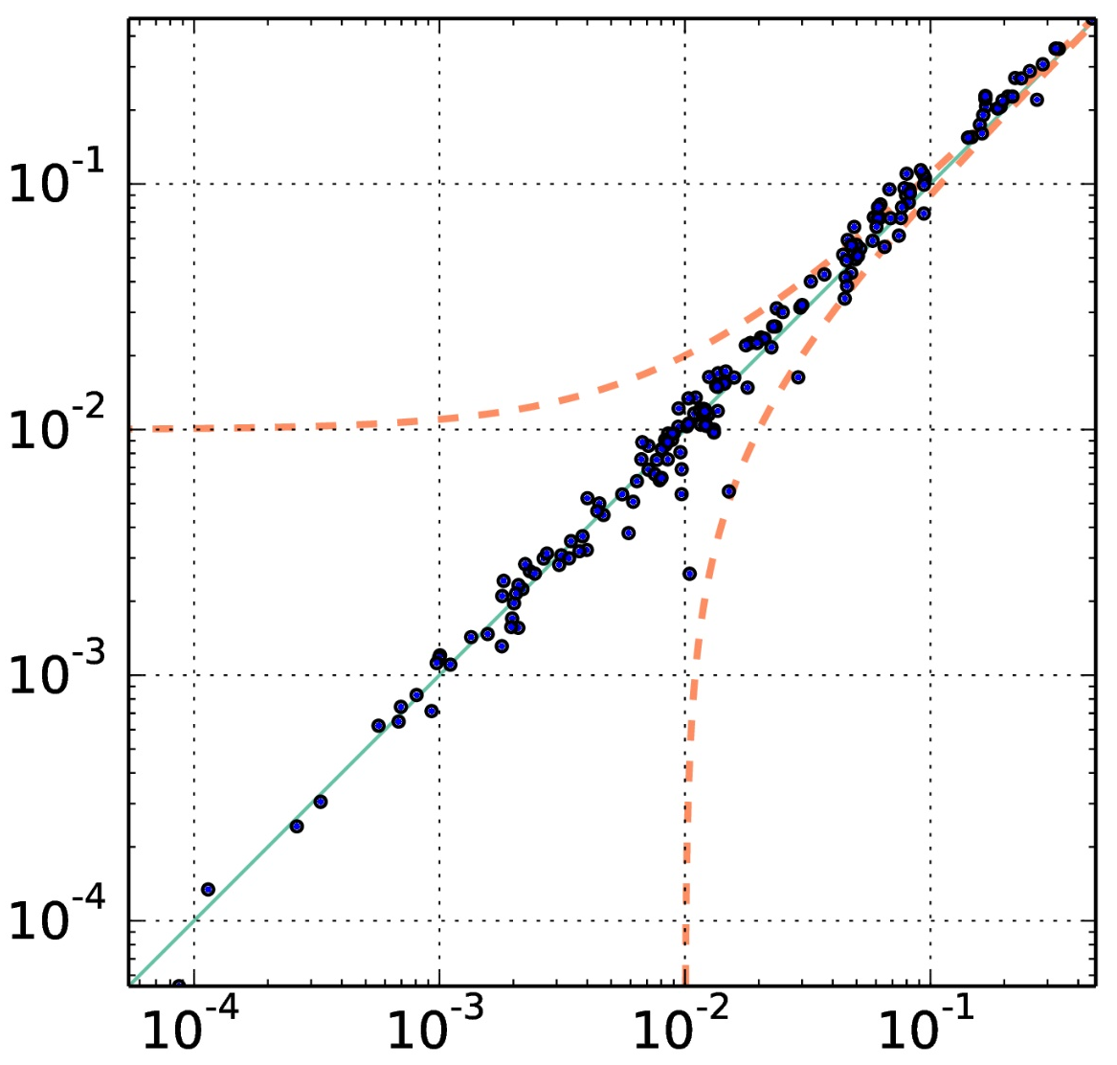


Advertising on own brand name
$$\text{NAB}(\text{ad})$$
$$\text{NAB}(\text{noad})$$
Notes:
When we compare the NAB of these two ad strategies on a scatter plot, the result looks something like this. On the x-axis is the NAB for strategy when ad was not shown. On the y-axis is NAB for the strategy where ad is shown. This graph means that for advertisers who fall in the upper half of the graph advertising on brand name has a net benefit. For advertisers in the bottom half, advertising on their own brand is a net loss. The red dotted lines here show a delta-NAB of 0.01. As we can see, most advertisers cluster around the diagonal, meaning that the profit advertiser would see if they advertise are not much much better than if they do not advertise.

Slide 19
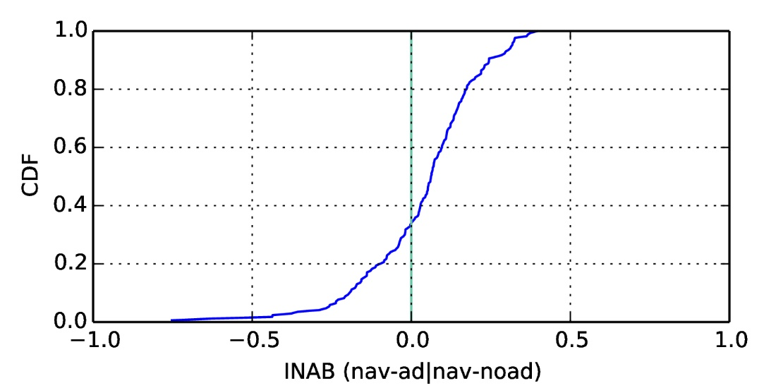
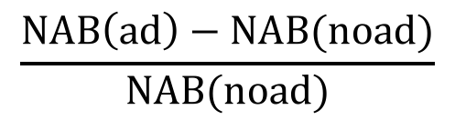
Incremental benefit is limited
32% advertisers net loss
Why do advertisers advertise for their brand name?
$$\frac{\text{NAB}\left(\text{ad}\right)−\text{NAB}(\text{noad})}{\text{NAB}(\text{noad})}$$
Notes:
To highlight this further, we plot the incremental benefit of advertising as a CDF here. A value of 0 means not advertising is just as profitable as advertising. A value of 1 means advertising is twice as beneficial and negative values mean advertising is a net loss.
For over 32% of the advertisers advertising on their own brand name is a net loss.
Then, why do advertisers advertise for their own brand name?

Slide 20
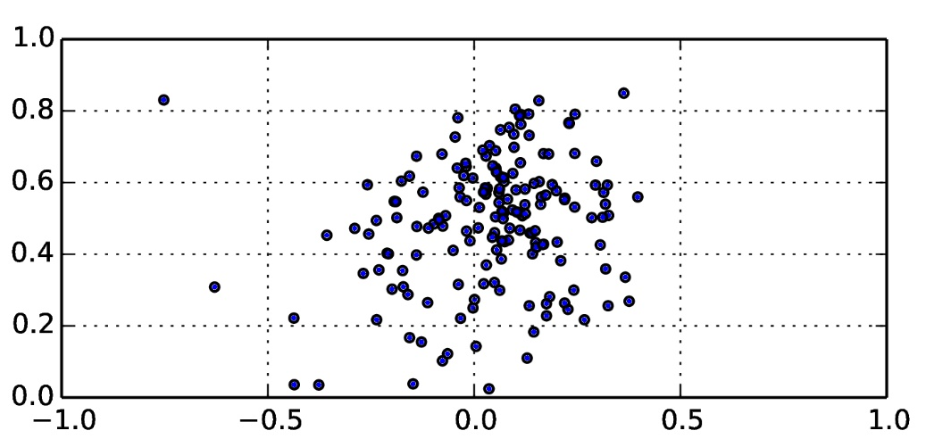
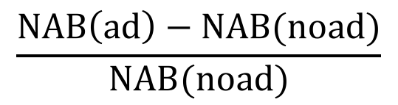
Click-through-rate is misleading
Click-through-rate not correlated to campaign performance
CTR
$$\frac{\text{NAB}\left(\text{ad}\right)−\text{NAB}(\text{noad})}{\text{NAB}(\text{noad})}$$
Notes:
The answer, we believe, lies in the choice of metrics. Conventional metrics like click-through rates which measures the number of ads clicked as a share of number of times the ad is shown, can be mis-leading.
When we plot the incremental benefit of advertising against the click-through rate observed by the advertisers, we see that there is not much correlation. Campaigns could have high click through rate making them look impactful but could be loss making.

Slide 21
Summary
We introduce NAB which can be used measure profitability of an ad campaign without access to profit information from advertisers
Advertisers often target the wrong users
  Common strategy of targeting own brand name can be a net loss
  Commonly used metrics can be misleading

Slide 22
Thank you
Notes:
I would like to thank my advisor from UCSD and my collaborators at Microsoft and Microsoft research for their help with this work. Thank you, I would be happy to answer any questions.

Slide 23
Measuring campaign performance
Value of conversion for advertiser is unknown
Advertiser diversity
  Six orders of magnitude difference on total ad spend
  Ad strategy comparison has to be advertiser centric
Query level analysis leads to poor statistical significance
  When comparing ad strategies we should aggregate similar queries
Notes:
But measuring campaign profitability from the vantage point of the search engine is hard. Because, straight out of the gate, at the search engine, we do not know how much a conversion is worth to the advertiser.
Next, there is huge diversity among advertisers who run campaigns with the search engine. There is a six orders of magnitude difference between advertisers in how much they spend on search advertising campaigns. So, any ad strategy comparison that we do has to be advertiser centric.
Finally, one of the key normalizer in search ads is the user query because the query captures user intent. But, analysis at a query level would lead to poor statistical significance. Even the top queries account for a very small share of the overall query volume. So, when comparing ad strategies we need to aggregate similar queries.

