Slide 1


Interpreting Advertiser Intent in Sponsored Search
Bhanu C Vattikonda, Santhosh kodipaka, hongyan zhou, vacha dave, saikat guha, alex c snoeren
Notes:
Hello everyone, my name is Bhanu, today I am going to present our work on Interpreting Advertiser Intent in Sponsored Search. This work was done in collaboration with Santhosh, Hongyan, Vacha and Saikat from Microsoft and my advisor Alex at UCSD.

Slide 2
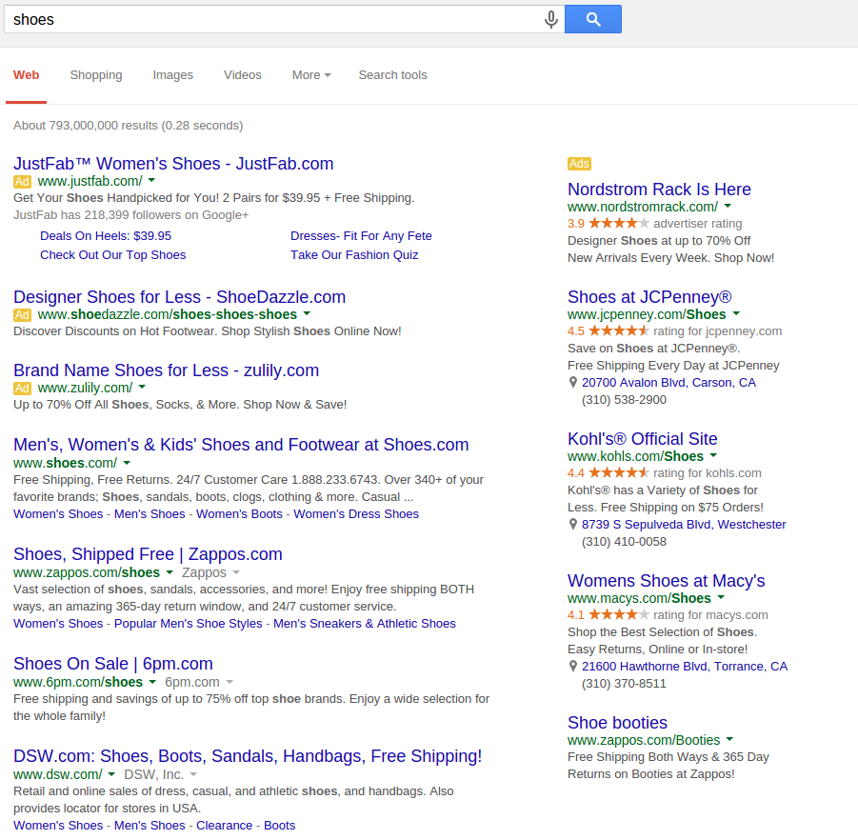
Query
Sponsored
results
Organic
results
Notes:
Search engines that we use every day return a page that looks like this in response to a user query. The page contains are two types of results. Organic results which are chosen from around the web based purely on their relevance to the user query and sponsored results which are chosen based on their relevance and the price that advertisers are willing to pay to have their ad shown to the user. This form of advertising is called sponsored search. Let’s take a closer look at what’s happening with the ads.

Slide 3
Query
shoes
Ad Keyword
women’s shoes
Notes:
The user searched for “shoes”, which is the query here. The search engine now wants to find ads which would be suitable to this user.
It finds an ad by JustFab which the advertiser has targeted towards “women’s shoes”. The words that the advertiser chooses to target are called ad keywords and they represent the users the advertiser wants to attract. The search engine decided to show this ad because it is relevant to what the user is searching for and JustFab is willing to pay the search engine to have their ad shown to the user. This is great for advertisers because they can show their ads knowing what the user is looking for. And it’s also good for users because they find that the ads are also relevant to what they are searching for and therefore less intrusive than conventional ads.

Slide 4
Huge and growing industry
20%
Notes:
It is no surprise then that sponsored search revenues have grown rapidly over the last decade.
However, sponsored search does not always work that well. Search engines do show irrelevant ads to users

Slide 5
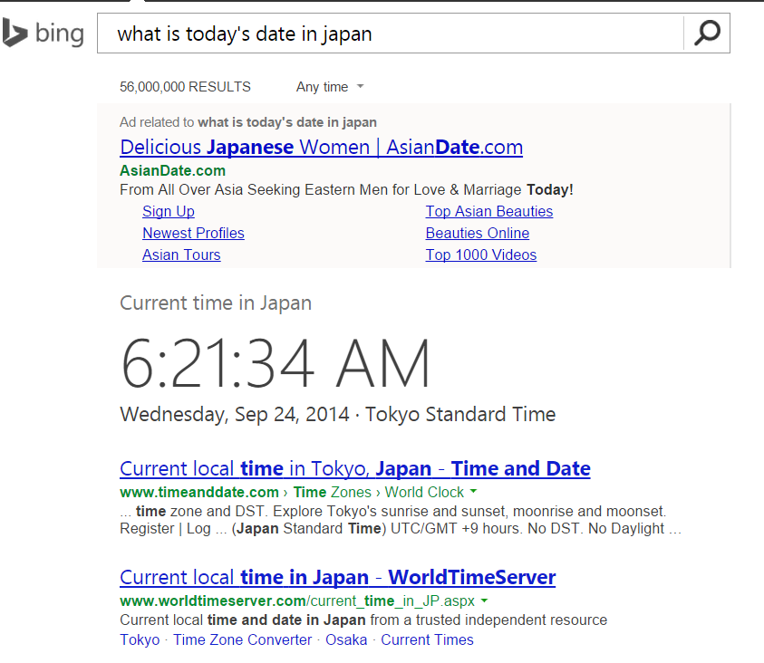
Query
What is today’s
date in Japan
Ad Keyword
Date Japan
Notes:
Let’s look at a few examples.
The user intends to find today’s date in japan .
The advertiser intends to advertise a Japanese dating website and wants to attract users who are searching for a date in Japan. But, the search engine mismatched user and advertiser intent and showed an irrelevant ad. The user clearly got more than what she was searching for. Note that here the ad keyword is not present anywhere in the ad itself. It is a way for the advertiser to choose which users to target without having to show those keywords to the user.

Slide 6
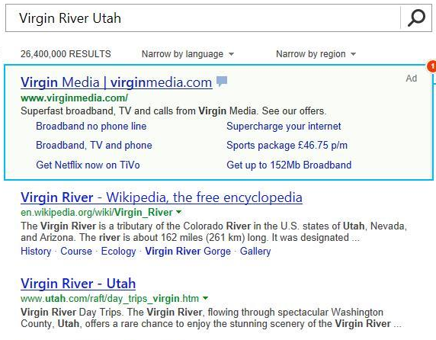
Query
Virgin River Utah
Ad Keyword
Virgin Media
Notes:
In this second example, the user intends to find information about virgin river Utah which is a river in the united states. The advertiser intends to attract users who are searching for “virgin media”. So, they target the ad keyword “virgin media”. But, the search engine again mismatched user and advertiser intent and showed an irrelevant ad to the user.
Part of the reason why this happens is because when the advertiser chose the keywords they would like to target they tell the search engine to show their ad whenever relevant. Now, when the search engine is trying to find ads to be shown to this user, it thinks an ad for “virgin media” is suitable. And it is not hard to see why that would happen. There is textual similarity between the user query and content of the ad itself, which is highlighted. There is textual similarity between the user query and ad keyword making the search engine think that this is the user advertiser wants to attract. So, the search engine did a poor job of matching what the user wants and who the advertiser wants to target because it is a hard thing to do.

Slide 7

Query
Virgin River Utah
Ad Keyword
Virgin Media
We use organic search results for ad keyword
Notes:
But if we look closely at the organic results, the search engine did a good job identifying organic results that are suitable for the user. So, the search engine has clearly figured out what the user wants. It did a poor job of understanding who the advertiser wants to target.
Since the search engine is good at getting organic results for a query, our idea is to use organic results for the ad keyword to understand what the advertiser wants to target.

Slide 8
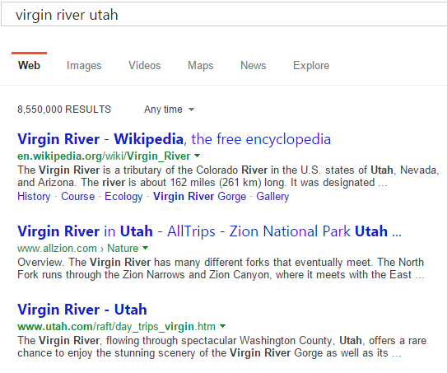
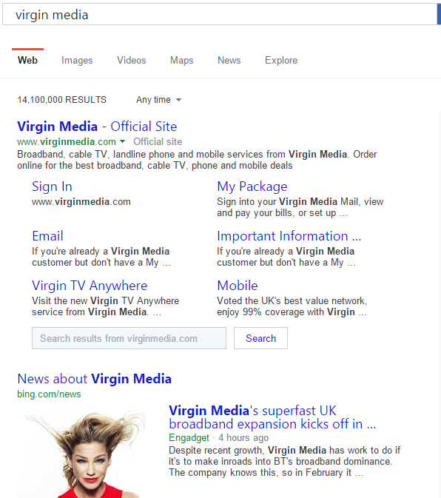
Capturing user and advertiser intents
Notes:
If we do that then, for our example, we would have something like this. On the left are search results for “virgin river Utah” and on the right are search results for “virgin media”. The left side results show that the user wants to know about “virgin river Utah”. The right side tells us that the advertiser wants to attract users who are looking for the virgin media telecom company. Once we have this, we can tell if the ad is targeted towards this user or not.

Slide 9
Overview
Mismatching advertiser and user intent
Organic results are accurate
Ad keywords capture advertiser intent
  Ad keyword is very brief
  Use organic results for ad keyword to interpret advertiser intent
Notes:
What we have so far is a search engine that is mismatching user and advertiser intent.
But, the search engine is generating accurate organic results. So, it understands what the user wants.
And, advertisers are telling the search engine what they want to target using the ad keywords. To show ads to the right users, we should fully examine what the advertiser intent is when they target particular ad keywords. In particular, we can use organic results of the ad keyword itself to interpret advertiser intent.

Slide 10
Relevance in Sponsored Search
Notes:
Before I dive into our approach and the solution, let me provide some background on how a search engine ensures that relevant ads are shown to the users.

Slide 11
Ad selection pipeline
Ad Corpus
(M’s of ads)
Ad retrieval
Relevance
Auction
User
Query
Quick look up
“virgin media” matched to “virgin river Utah”
Measure the relevance of each ad to user query
Virgin media ad seen as relevant to “virgin river Utah”
Choose ads that provide most revenue
Notes:
When the user query comes in, the search engine chooses ads to be shown to users using a multi-stage pipeline:
In the first stage it quickly looks up ads from an ad corpus containing millions of ads. At this stage, the goal is to find as many ads as possible which would be even remotely suitable to the user query. This stage has to perform efficiently at a very large scale because the lookup has to happen over millions of ads. It is at this stage “virgin media” was thought to be a suitable ad for the query “virgin river Utah”. This is expected because the idea of this stage is to identify as many ads as possible which would be even remotely related to what the user is searching for.
For the ads that have been selected, search engine computes how relevant each ad is to the query. This stage then evaluates the relevance of each ad chosen in the previous stage to the user query. The goal of this stage is to make sure ads that are being selected are relevant to the user query. This stage should have caught it. However, this stage also concluded that “virgin media” ad is relevant to “virgin river Utah”.
Finally the search engine runs the auction where it chooses ads which would provide the most revenue.
In our work, we are trying to improve the quality of ads that are shown to the user. This is done at the relevance stage. The goal of relevance stage is to make sure that ads chosen are relevant to the user. It does this by measuring relevance of an ad to query for each (query, ad) pair chosen by retrieval stage. The search engine takes a supervised machine learning approach to achieve this.

Slide 12
Supervised machine learning
Training set
(query, ad, judgement)
Compute numerical features
E.g., no. of words common in query and ad keyword
(features, judgement)
Training
Trained Ranker
Ranker can compute relevance of (query, ad) pair
Notes:
We start with a training set containing (query, ad) pairs and judgement scores provided by human judges. The judges give a high score of 5 if the ad is relevant to the corresponding query and 1 if the ad is totally irrelevant to the corresponding query.
From these (query, ad) pairs numerical features are computed which capture how relevant an ad is to query. These features could be something like, the number of words common between query and ad keyword.
A ranking algorithm is then trained using these features to generate a trained ranking model. The trained ranker can then compute the relevance of an ad to query given a (query, ad) pair. The accuracy of the ranker depends on the ability of the features to capture the relevance of the ad to query. So, identifying the right features to train the ranker is critical.

Slide 13
Signal sources
Query
Virgin River Utah
Ad Keyword
Virgin Media
Notes:
Going back to our previous example, we want to compute features which tell us if the ad is relevant to query or not.
To compute these features we have a few sources of information. We have the query that the user submitted and the ad keyword which the advertiser targeted.

Slide 14
Signal sources
Query
Virgin River Utah
Ad Keyword
Virgin Media
Ad Creative
Notes:
In addition to these two, we have the ad creative which is also mostly a textual element. And finally, we have the landing page.

Slide 15
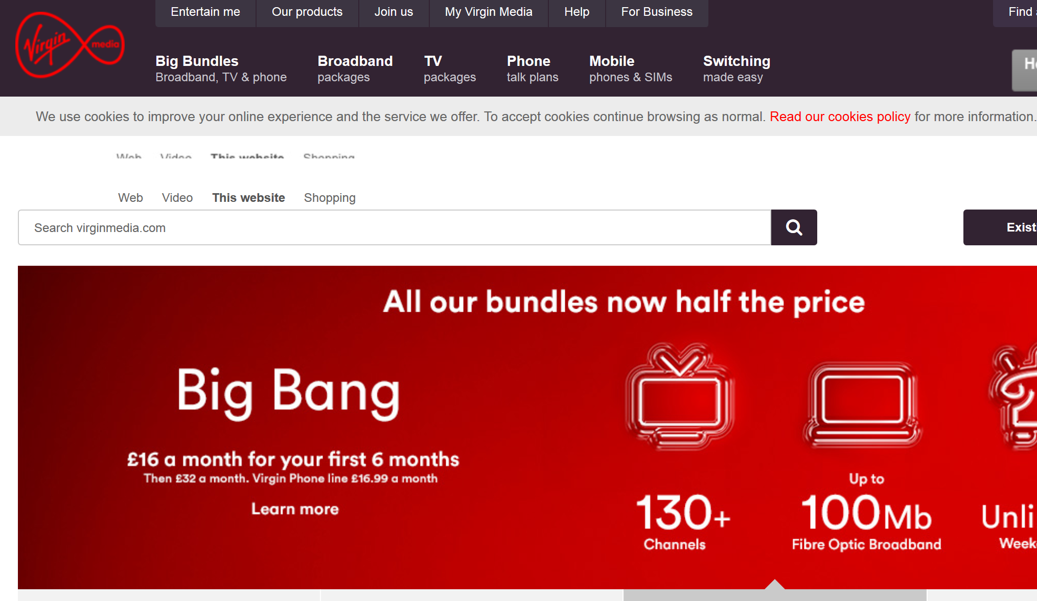
Signal sources
Query
Virgin River Utah
Ad Keyword
Virgin Media
Ad Creative
Landing page
Notes:
If the user clicks on the ad she is taken to the landing page which might look like this.

Slide 16
Features from signal sources
Query and ad creative
  Query: “virgin river Utah”, ad title: “virgin media | virginmedia.com”
  Word bigram overlap: 0
Query and landing page
  Query: “virgin river utah”, landing page title: “Virgin Media – Cable Broadband, Digital TV”
  Ordered word bigram overlap: 0
Query and ad keyword
  Query: “virgin river Utah”, ad keyword: “virgin media”
  Word unigram overlap: 0.5
Notes:
From these signal sources, we compute features which capture if the ad is relevant to the query or not. Let’s say we want to see if the ad would appear relevant to the user, we can check if the query and ad creative overlap or not. For this, we could compute a word bigram overlap between the title of the ad creative and query.
To see if the user would get what is being promised to them in the ad we check if ad creative and the landing page mean the same. We can compute an ordered bigram overlap between the two.
Finally, to see if this is the user advertiser is targeting. We can check by checking of the query and ad keyword match. We can compute a word unigram overlap between the query and the ad keyword. Features like these, along with hundreds of other features are used to determine the relevance of an ad to query. But the challenge is, this is hard to do.

Slide 17
Interpreting user and advertiser intent
Query and ad keyword are very short -- 2.5 words on average
  Hard to determine user and advertiser intent
Query and ad keyword may mean same without overlap or vice versa
  Sneakers vs shoes
  Virgin river Utah vs virgin media
Use organic search results to boost query and ad keyword
Notes:
This is because query and the ad keyword are typically very short. 2.5 words on average which makes it hard to see if they mean the same thing. Ad creative and landing page are easier because they have more text. And, situations can happen where they may mean the same semantically without much string overlap. Or, they may have overlap without meaning the same. For example, shoes and sneakers have little overlap but mean very much the same, whereas, “virgin river Utah” and “virgin media” have little in common despite the overlap. In our example, this is what happened.
Our solution is to use organic search results to get more text which will then enable us to tell if the user query and ad keyword mean the same or not.

Slide 18
Matching user and advertiser intents
50% overlap
25% overlap
3% overlap
Notes:
If we do that then, for our example, we would have something like this. On the left are search results for “virgin river Utah” and on the right are search results for “virgin media”. The left side results show that the user wants to know about “virgin river Utah”. The right side tells us that the advertiser wants users who are looking for the virgin media telecom company. Let’s say we use word unigram overlap to see if the user query and ad keyword mean the same thing.
Previously, we would have computed the word unigram overlap over query and ad keyword resulting in a 50% overlap.
Now, if we compute the same over the titles of the top organic search result, the overlap falls to 25%.
If we use even richer pieces of text, then things start moving further apart. When we use the text overlap of the search result snippets, we find a very small overlap between query and ad keyword. In the case of virgin river Utah, the text is all about river, Colorado, Utah etc. Whereas in the case of virgin media, the text is all about broadband, tv and telephone services. This shows us that this is not the user advertiser wants to attract and this ad is not suitable to the user.

Slide 19
Improving relevance ranker
Introduce features capturing overlap between user and advertiser intents
User intent captured using search results for user query
Advertiser intent captured using search results for ad keyword
75 Features introduced:
  Overlap between elements of search results
  Overlap between ad creative and search results for ad keyword
Notes:
To improve the relevance ranker we do exactly this. We introduce features which capture the overlap between user and advertiser intent. User intent is captured using search results for the user query and advertiser intent is captured using search results for the ad keyword. From this, we compute 75 different features which capture the similarity between the search results for user query and ad keyword. Then, we also compute features which capture how much of an overlap there is between the creative and the search results for ad keyword.

Slide 20
Evaluation
Notes:
Now that we have the features that we think will allow us to improve the relevance ranker, we evaluate how these features actually perform.

Slide 21
Measuring performance of ranker
Validation set
(query, ad, judgement)
Compute numerical features
(query, ad, judgement)
Trained Ranker
(query, ad, relevance)
Compare ranker result against human judgement
Notes:
To measure the impact of the features that we introduced we use a hold out validation set. The validation set that we have contains (query, ad) pairs along with human judgements. These human judgements are similar to the judgements in the training set, scored from 1-5 where a (query, ad) pair is given a score of 5 if the ad is very relevant to the corresponding query.
From this we compute numerical features, which are then passed to the trained ranker to compute a relevance score for each (query, ad) pair. The relevance scores generated are then compared against the relevance scores given by human judges.

Slide 22
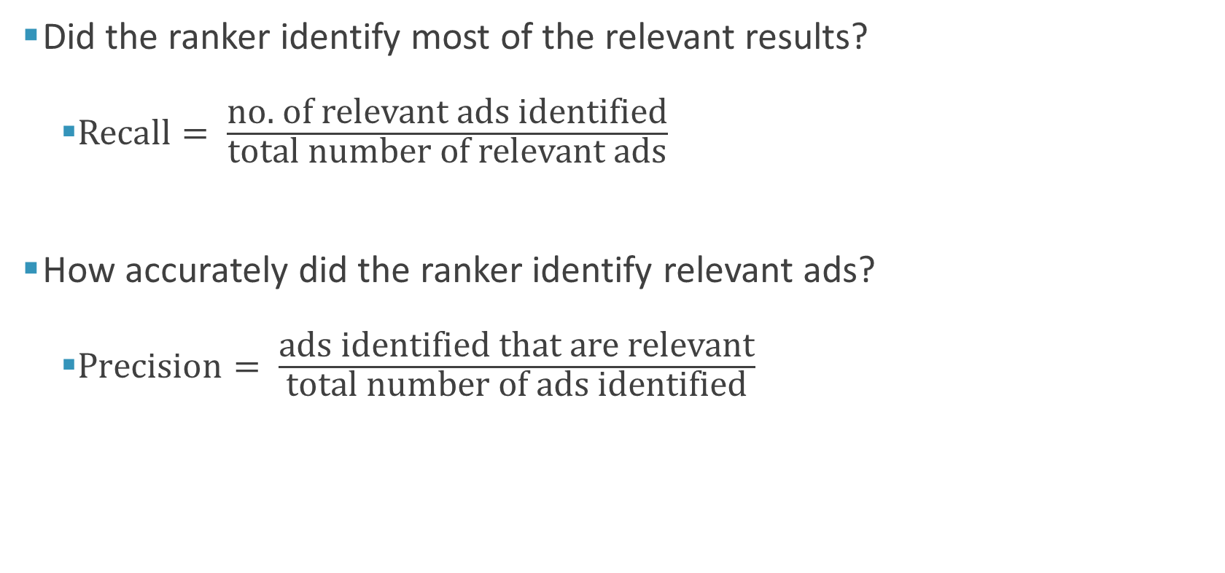
Evaluating performance of ranker
Did the ranker identify most of the relevant results?
  $\text{Recall}= \frac{\text{no}\text{. }\text{of} \text{relevant} \text{ads} \text{identified}}{\text{total} \text{number} \text{of} \text{relevant} \text{ads}}$
How accurately did the ranker identify relevant ads?
  $\text{Precision}= \frac{\text{ads} \text{identified} \text{that} \text{are} \text{relevant}}{\text{total} \text{number} \text{of} \text{ads} \text{identified}}$
Notes:
To measure the performance of the ranker we ask questions like this. Did the ranker identify most of the relevant results? This is the recall of the ranker, which is share of relevant ads identified by the ranker as relevant. The other question we ask is: How accurately did the ranker identify relevant ads? Precision measures the share of all the ads that have been identified by ranker as relevant, that are actually relevant.

Slide 23
Precision-Recall
Low precision results in irrelevant ads being shown to users
  Bad user experience
  Wasteful spend for advertisers
Low recall would lead to missed chances
  Lost revenue opportunities for search engine
  Lost targeting for advertisers
  Lost desirable ads for users
Notes:
In the context of sponsored search relevance ranking low precision leads to irrelevant ads being shown to users. This leads to bad user experience and wasteful spend for advertisers.
A low recall would mean missed chances. Lost revenue opportunities for the search engine and lost targeting chances for advertisers.

Slide 24
Dataset and approach
Data from a large search engine
  1.28M (query, ad) pairs of training data
  320k (query, ad) pairs of validation data
  Several hundred existing features
The ranker is trained on a combination of the features we introduce and existing production system features
Compare new ranker to current ranker
Notes:
To evaluate the impact of these features on relevance ranker, we use data from a large search engine containing 1.28M labeled query ad pairs of training data, 320k pairs of validation data. The ranker uses several hundred features.
We train the new ranker on a combination of the features we introduce and existing production system features.
We then compare the precision-recall curve of the resulting ranker to the current production ranker.

Slide 25
Query and ad matching
Query and ad matched using different match types chosen by advertiser
Exact match
  Ad keyword: “shoes” and query: “shoes”
Broad match
  Ad keyword: “shoes” and query: “sneakers”
Features we introduce capture similarity between query and ad keyword
Notes:
Before I get to the results, there is one detail I need to point out. You may recall there was a stage prior to the relevance stage which actually matched the ad to query. In that stage, query and ad are matched using different match types chosen by advertiser. There are two common match types
One of them is called exact match. If the advertiser chooses this matching type then their ad is matched to the query only if ad keyword and query are the same.
The other one is called broad match. Where the ad is matched to the user query if ad is just “related” to the query. All the examples of irrelevant ads that we saw fall into the broad match category.
Features that we introduce capture similarity between query and ad keyword. So, we do not expect to see much gains in the case of (query, ad) pairs matched using exact match. This is because in the case of exact match query and ad keyword are already the same.

Slide 26
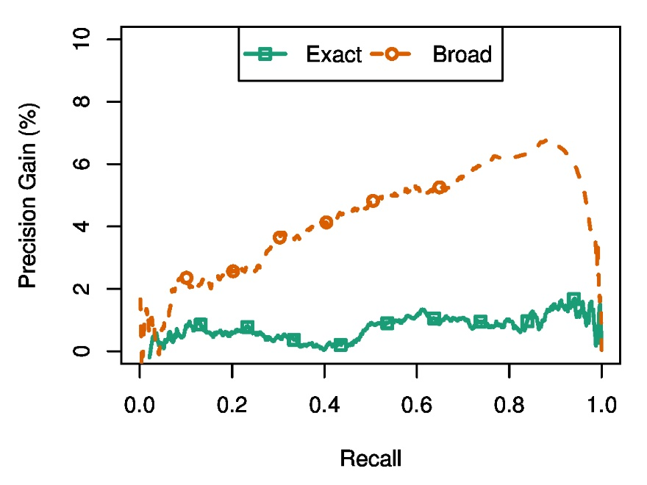
Significant improvement in broad match
2.7% improvement in area under precision-recall curve
Notes:
We measure the improvement in the ranker by measuring the gains in precision at different recall values for (query, ad) pairs matched using exact and broad match. In the case of exact match, we see lower gains which is to be expected. However, in the case of broad match we see tremendous gains. This is because the features we introduced are designed for this scenario. Overall, the new features we introduce lead to a 2.7% improvement in area under the precision-recall curve. As you may recall from the keynote this morning, improvements like these have tremendous business impact.

Slide 27
Summary
Mismatched user and advertiser intents leads to errors in sponsored ads
Interpreting ad keywords poses a challenge due to their brevity
Organic search results for the ad keyword capture advertiser intent
2.7% gain in area under precision-recall curve over production
Notes:
To summarize, Mismatched user and advertiser intents leads to errors in sponsored search. Interpreting advertiser intent using ad keyword improves sponsored search relevance ranker. We use the organic search results associated with ad keyword to capture advertiser intent and compute features. The features we introduce lead to a 2.7% improvement in the area-under the precision-recall curve over the production system

Slide 28
Thanks
Notes:
I would like to thank my advisor from UCSD and my collaborators at Microsoft and Microsoft research for their help with this work. Thank you, I would be happy to answer any questions.

Slide 29
Thanks

Slide 30
Backup

Slide 31
Organic results vs ad results
Organic and ad result goals are different
Ads “related” to user query
Example:
  User query: “prom dresses”
  Ad for Limousine service targeting “prom dresses”
  Good ad but bad organic result
Ad keywords are for targeting
Notes:
Actually no. Because the goals of organic and ad results are different. Organic results have to be exactly what the user is searching for. However, ads can be anything that’s related to what the user is searching for. For example, if the user query is “prom dresses”, an ad for Limousine service which targets “prom dresses” is a great ad. However, it would make for a poor organic result.
What this example shows us is that ad keywords allow an advertiser to tell the search engine the type of users they want to attract. We can actually use this information to see if current user is the user advertiser wants to attract or not. So, if we interpret the ad keyword well, then we should be able to tell if this user is desirable to the advertiser.

